Slide 1
Steering Committee Presentation
Establishing A Sandbox for Emerging Technologies and Innovation: Drones/UAVs

Slide 2
Meeting Agenda
2 | Background & sandbox definition | 25 | Initial Institutional Arrangements
3 | WC-DSBP and Business case Initiative objectives | 36 | Initial Regulation Sandbox Approval Process
5 | Phased Approach | 50 | Initial Financial Model Framework
6 | Project Timelines | 56 | Next Steps
7 | Location Selection Criteria | 57 | Appendices
14 | High-Level Site-Specific Analysis

Slide 3

Background and Definition of a Regulatory Sandbox
Background
The Western Cape (WC) is a leader in technology, financial innovation, and design in Africa. The WC Government’s strategic plan, Growth for Jobs (G4J), emphasizes technology as a key driver for economic growth. Developing a business case for a Regulatory Sandbox for drones and unmanned aerial vehicles (UAVs) is a pivotal step toward establishing a global hub for drone technology and innovation.
The intent of this initiative is to develop a conducive environment for fostering drone technology advancement, stimulating innovation, and attracting both local and international investment into the emerging aviation sector and its value chain.
Definition of Regulatory Sandbox
A Regulatory Sandbox is a tool which government and regulators may use to develop evidence-based research on how a new product, technology or business model works within a market and the novel outcomes which may be produced thereby.
This gathering of evidence may confirm or disprove regulatory concerns about the impact of the innovation and assist those innovations to reach the marketplace in a business and regulatory friendly manner.

Slide 4
WC-UAV Sandbox Initiative Objectives
The WC drones/UAV sandbox initiative holds immense strategic value for South Africa and the broader region that include:
Creates a globally recognised hub for drone technology and innovation.
Positions the Western Cape as a leader in the drone technology field.
Serves as a cornerstone for broader economic and technological advancement.
Fosters the broader intent of developing tech and innovation local talent.
Stimulates R&D activities related to drones and associated applications & industries
Encourages growth of supporting industries such as data analytics, software, development, and advanced manufacturing, drone payload systems and sensors.
Contribute to the potential of developing drone airport corridors for seamless drone operations (as the opportunity grows).
Facilitates applications in other sectors.
Align with South Africa’s vision of becoming a global leader in the aerospace sector.
Expected socio-economic benefits include job creation, skills development, and promotion of STEM education whilst attracting investment into the region.

Slide 5
Business Case objectives
To position South Africa as a leading hub for drone technology through a business case for the establishment of a regulatory sandbox in the Western Cape for Drones/UAVs. The intent of this initiative is to develop a to provide an overarching document to outline the strategic, operational, financial, and implementation approaches for establishing the regulatory sandbox in the Western Cape.
To serve as the foundation for guiding the successful establishment, sustainability, and economic growth of the drone sector to create a conducive environment for fostering drone technology advancement, stimulating innovation, and attracting both local and international investment into the emerging aviation sector and its value chain.
By enabling a competitive and supportive framework for drone/UAV technologies, the sandbox aims to attract both local and international stakeholders and investment from the global drone ecosystem.
01
02
03

Slide 6
2024 - 2025 WCP Drone Sandbox Phased Approach
1
2
3
4
5
6
Initial Stakeholder Engagement
Ground and Airspace requirements
Location Selection
Next Level Stakeholder Engagement
Final Business Plan
Way Forward
PHASE 1
Documented Stakeholder Approach
Stakeholder Engagement Plan
Initial Stakeholder Engagement online survey
Research design & Stakeholder engagement confirmed
PHASE 2
Phased Approach Identification
Ground footprint
Airspace allocation
Steercom meetings for approval
Engage with regulatory authorities
Collaborate with ATNS/SACAA
Department of Transport Engagement
PHASE 3
Location selection criteria
High-level site-specific analysis
Location selection approval
Site visit and site validation
Risk assessment
PHASE 4
Recommendations and findings
Operational Model and Concept of Operations
Implementation Model
Technical requirements
Financial models for minimum viable sandbox
Regulation Sandbox Approval Process
Institutional Arrangements
PHASE 5
2 live engagements with key stakeholders
Summary reports of workshop consultative forums & engagements with regulatory & transport authorities
PHASE 6
Drafts incorporating Phase 1 – 5
Consultation Sessions
Final Phase 1 Report
Final Phase 2 Report
Final Phase 3 Report
Final Phase 4 Report
Final Phase 5 Report
Final Business Plan

Slide 7
2024 - 2025 WC Drone Sandbox Timelines
Nov 24
Proposal Accepted
3 Dec 24
Initial CoP/ Steercom meeting
Mixed Methodology Research Design
Qualitative Research
Jan 25
Initial High-Level Presentation to WCP
Stakeholder Engagement
Jan 25
Steercom
Project Meeting
Phase 3: Location Selection
Location selection
criteria
Feb 25
Steercom Project Meeting
Insights, findings,
preliminary
recommendations
Implemen-tation Models
Feb 25
Steercom Approvals
2 live engage-
ments
with key stakeholders
Compile initial draft
Editing &
Proofing
Mar 25
Steercom Project Meeting
Review Business Plan
Drafts
for approvals
Phase 6: Final Business Plan
1
2
3
4
5
6
Nov 24
Appoint-ment by WCP
Initial briefing meeting WCP
Phase 1: Identification/ Initial Stakeholder Engagement
Documented Stakeholder Approach & Engagement Plan
Initial Stakeholder Engagement online survey
Research design & Stakeholder engagement confirmed
Phase 2: Ground and Airspace requirements
Phased Approach identification
Ground footprint
Airspace allocation
Consultation Relevant Authorities
Phase 4: Way Forward
Operational Model
Concept of Operations
Regulation Sandbox Approval Process
Institutional Arrangements
Phase 5: Next-Level Stakeholder Engagement
Summary reports of workshop consultative forums & engagements with regulatory & transport authorities
Final Design and Proofing
Drafts incorporating Phase 1 – 5
Consultation Sessions
High-level
Site-specific
analysis
Location
selection
approval
Nov 24
Dec 24 - Jan 25
Dec 24 - Jan 25
Jan - Feb 25
Dec 24 – Mar 25
Feb – Mar 25
14 Mar 25
1
2
3
4
5
6
Project Inception
Initial Debrief Meetings
Submission of initial Project Plan
Team formation
Timelines
Key Phases
PHASE 1
Documented Stakeholder Approach
Stakeholder Engagement Plan
Initial Stakeholder Engagement online survey
Research design & Stakeholder engagement confirmed
PHASE 2
Phased Approach Identification
Ground footprint
Airspace allocation
Consultation with relevant regulatory authorities
PHASE 3
Location selection criteria
High-level site-specific analysis
Location selection approval
Site visit and site validation
Risk assessment
PHASE 4
Recommendations and findings
Operational Model and Concept of Operations
Implementation Model
Financing Models for Minimum Viable Sandbox
Regulation Sandbox Approval Process
Institutional Arrangements
PHASE 5
2 live engagements with key stakeholders
Summary reports of workshop consultative forums & engagements with regulatory & transport authorities
Phase 6
Drafts incorporating all phases
Consultation Sessions
Project Plan
Final Phase 1 Report
Final Phase 2 Report
Final Phase 3 Report
Final Phase 4 Report
Final Phase 5 Report
Final Business Plan

Slide 8


Location Selection Criteria

Slide 9

Process to Develop High-Level Site Selection Criteria
Selection
Criteria
Provide a weighted comparison built on analysis of specific elements
Add sub-criteria to deepen the specific understanding of each criteria
Review 10 High-level
Site Selection Criteria
1
2
3
Identify which qre aviation-specific
10 top criteria weighted
Ensure the broad range of stakeholders and needs are captured in the 10 criteria
6
5
4
Validate with key stakeholders
Score and weight each sub-criteria and apply to six key sites
Determine the overall weighing of the criteria relative to definitions
7
8
9
Final checks
validation with aviation regulatory bodies
Summary of weighting and scoring of six key sites
Present findings
to SteerCom with recommendations
WC site selection
approvals

Slide 10
High-Level Weighted Site Selection Criteria
Selection
Criteria
2%
25%
Domestic & FDI Attraction Potential
AVIATION | Airspace availability & compliance
10
1
AVIATION | Security & Safety
20%
Access to talent & R&D ecosystem
3%
9
2
Proximity to existing infrastructure
13%
Regulatory & Zoning Compliance
8
3
5%
7
4
Environmental impact
AVIATION | Future Growth & Scalability
12%
5%
6
5
Community impact & acceptance
AVIATION | Industry Acceptance & Support
7%
8%

Slide 11
Development of sub-criteria – 1 to 3
Selection
Criteria
Weighted
Rank
Key Criteria
List of Sub-Criteria for evaluation
Air risk considerations - availability of segregated airspace with least potential for traffic and/or interference
Ground risk considerations - Presence of surrounding hazards that could create a risk to third parties and property, create a hazard to drone operations in the sandbox
Ability of municipality to liaise with relevant with aviation authorities for site governance
AVIATION |Airspace availability/airspace and ground-based risks
1
2
AVIATION |Security
Distance to municipal “red zones” for ease of securing perimeter for the site (sandbox, infrastructure and equipment) for take off and landing, and ensuring security of sandbox infrastructure, participants and equipment.
Operational security to protect site users as an element of governance and management of the site (AVSEC requirements).
3
Proximity to existing infrastructure
User request for no more than 2 hours' drive from Cape Town (practicality)
Proximity to nearest SEZ
Proximity to economic hubs (multi-sector)
Access to internet/wifi capability for data downloads (fibre capability best)
Existing support infrastructure - electricity, water, sanitation and shelter
General accessibility for users to the site - road access and terrain harshness

Slide 12
Development of sub-criteria 4 - 6
Selection
Criteria
Weighted
Rank
Key Criteria
List of Sub-Criteria
Ease of extending the geographic, land-based footprint of the sandbox for future operational expansions
Existing or future land use and zoning plans that support or conflict with the initiative
Scalability in terms of airspace expansion, including BVLOS applications
Number and proximity to skilled labour, resources and services to build scalable operations
AVIATION | Future Growth & Scalability
4
AVIATION| Industry Acceptance & Support
Proximity - general attractiveness of location to potential users
Proximity to facilities with accommodation, shops and other basic amenities
5
Level of municipality endorsement to drive the project
Proximity to sensitive sites at risk of noise, safety and privacy disruption (conservation, medical, schools, old age homes, residential areas and agriculture (animals))
Potential economic growth/ employment opportunities benefitting the community (source: IDP)
6
Community impact & acceptance

Slide 13
Development of sub-criteria 7 - 10
Selection
Criteria
Weighted
Rank
List of Sub-Criteria
Key Criteria
Proximity to sensitive eco-systems with protection status (IDP, Biodiversity Plans)
Size of footprint for sandbox
Proximity - potential for future environmental or ecological risks with future expansions
Potential public or regulatory 'push-back' - based on proximity to sensitive locations
7
Environmental impact
Regulatory & zoning compliance
Municipality willingness to engage to ensure regulatory and zoning compliance
Municipal zoning and land use planning frameworks relative to IDP information
8
Proximity to research institutions, universities and technical training facilities, research facilities (academics)
Physical access to industry experts and drone/ aerospace talent pools - CBDs and drone manufacturers (practical implementation)
9
Access to talent and R&D ecosystem
10
Domestic and FDI Attraction Potential
Proximity to research institute with aviation components (school, university or laboratory)
Potential attractiveness to FDI investors in drone sector (e.g. market connectivity or recent, existing and future domestic and FDI programmes)
Proximity to potential areas of application (e.g. agriculture hubs, viniculture centres, wind farms, mining)

Slide 14
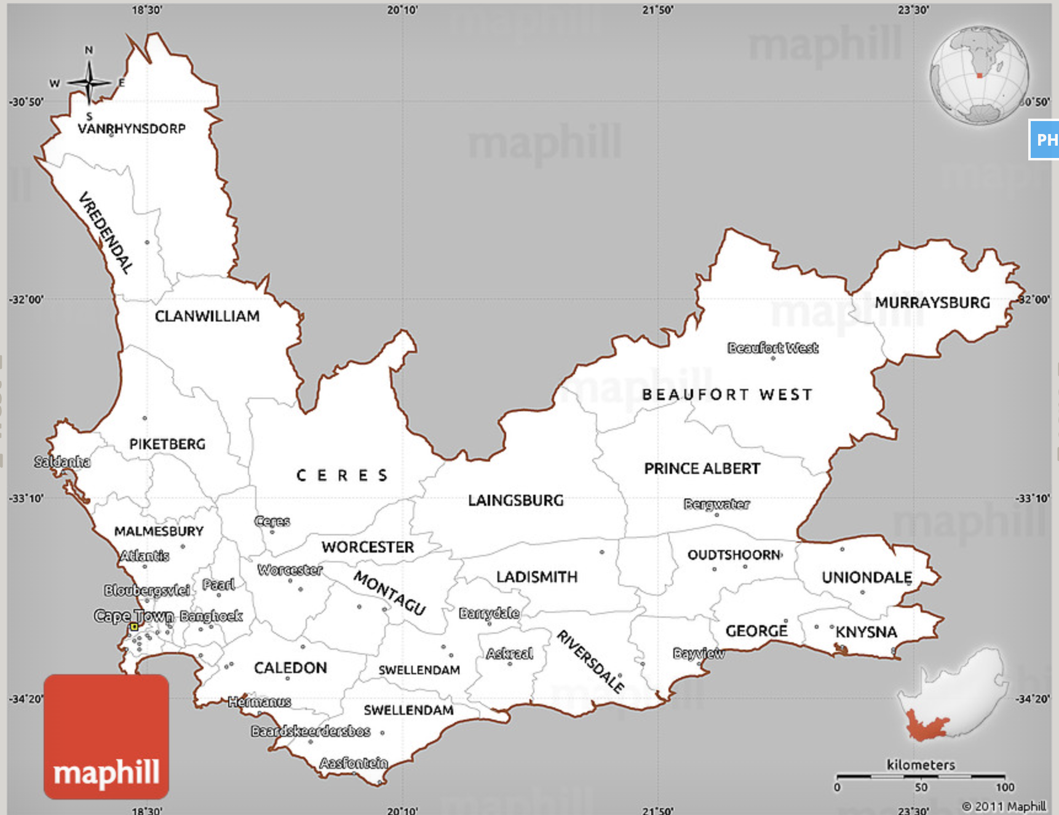
5 Selected sites for evaluation
Selection
Criteria
Five sites provided by WC
Sandbox project to provide location agnostic analysis
Technical founding
Ground and airspace requirements
Representation of 10 key elements against each site
Scoring of all five sites against technically founded criteria
Saldanha
1
Atlantis
2
5
Karoo
3
Stellenbosch
4
George

Slide 15

High-level site-specific analysis

Slide 16

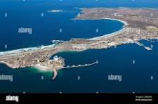

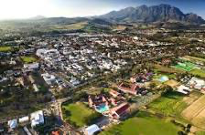

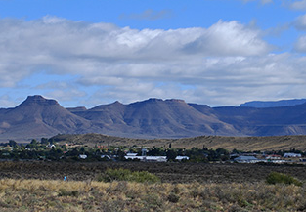
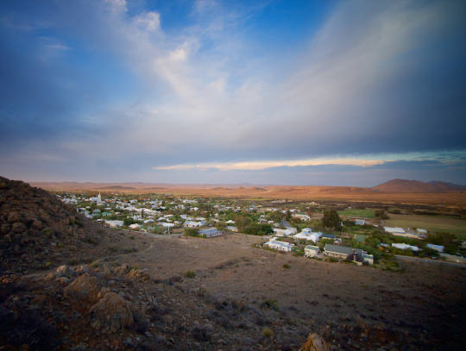
6 Selected locations and scoring
Site-specific
Analysis
1
2
3
3
4
5
6
Saldanha
Site location: north of Saldanha Bay
Atlantis
Site location:
W of Atlantis SEZ
Stellenbosch
Site location:
E of Somerset West
George
Site location:
North of George
Karoo
Beaufort West
Site location: South of BW
Karoo
Prince Albert
Site location: 7km W of PA
Score: 4.10
Score: 3.39
Score: 2.54
Score: 3.67
Score: 3.92
Score: 3.23

Slide 17
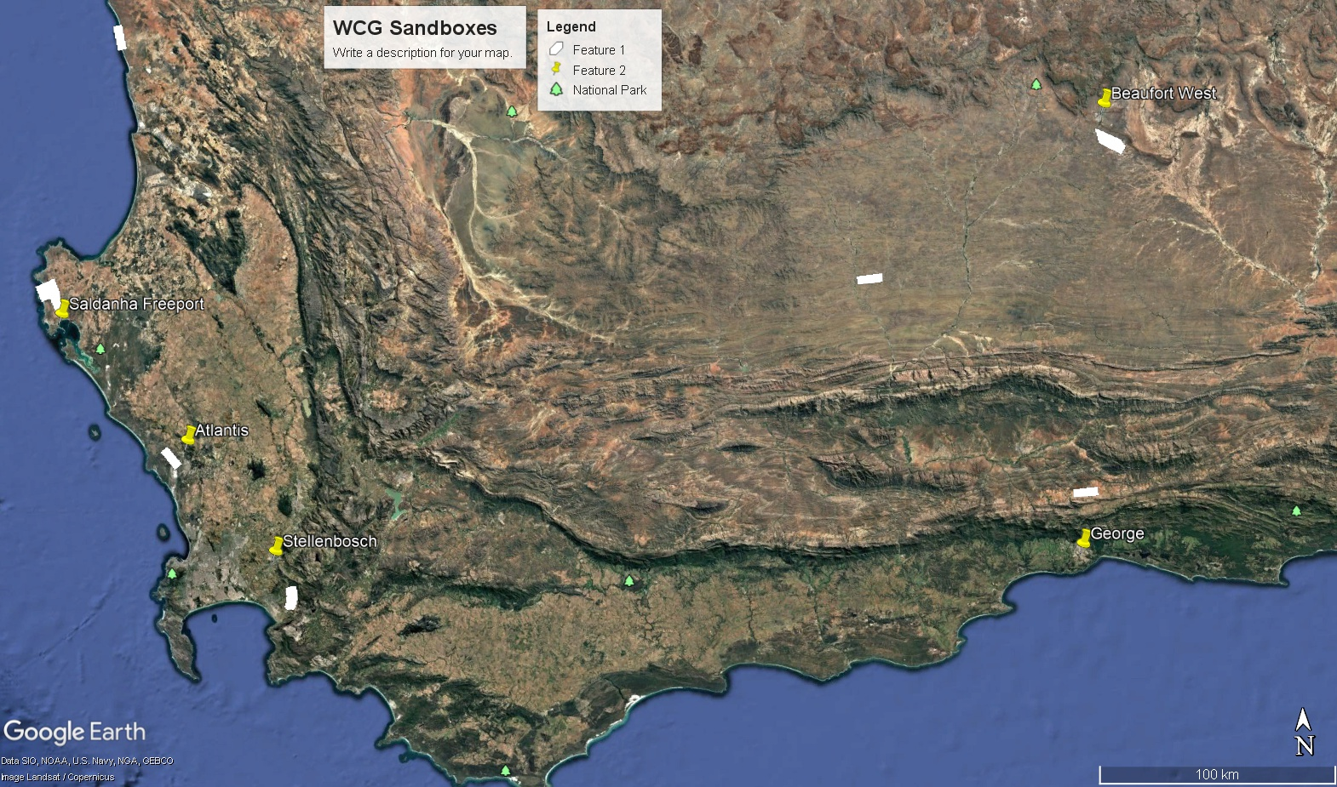
WC Province GIS map with sandbox locations
Site-specific
Analysis

Slide 18
Scoring and weighting methodology
Site-specific
Analysis
 |  |  | Severity
Risk Matrix |  |  | 5 | 4 | 3 | 2 | 1
 |  |  | Catastrophic | Hazardous | Major | Minor | N/A
Probability Proximity + Density | 5 | Certain | 25 | 20 | 15 | 10 | 5
 | 4 | High | 20 | 16 | 12 | 8 | 4
 | 2 | Medium | 15 | 12 | 9 | 6 | 3
 | 2 | Low | 10 | 8 | 6 | 4 | 2
 | 1 | N/A | 5 | 4 | 3 | 2 | 1
Ground Risk
(78)
Air Risk
(17)
Climatic Risk
(4)
Safety
Risk Score | Matrix Score | Risk Level | Sandbox Location Viability
20 to 25 | 1 | Extreme | Completely non-viable from a safety risk point of view.
15 to 19 | 2 | High | Non-viable from a safety risk point of view
10 to 14 | 3 | Medium | Mildly viable from a safety point of view.
6 to 9 | 4 | Low | Potentially viable from a safety risk point of view.
1 to 5 | 5 | N/A | Completely viable from a safety risk point of view.
Best Location
Airspace availability and airspace and ground risk (3) [25%]
Proximity to existing infrastructure (8) [13%]
Environmental impact (4) [5%]
Community impact & acceptance (3) [7%]
Access to talent & R&D ecosystem (2) [3%]
Security (2) [20%]
Regulatory & zoning compliance (2) [5%]
Future growth & scalability (4) [12%]
Domestic and FDI attraction potential (3) [2%]
Industry acceptance & support (2) [8%]
General Proximities
Stakeholder Input
Municipal Data
Case Studies
Scoring
1
2
3
4
5
Accessibility
Factors
Economics
Accessibility
Economic
Factors

Slide 19
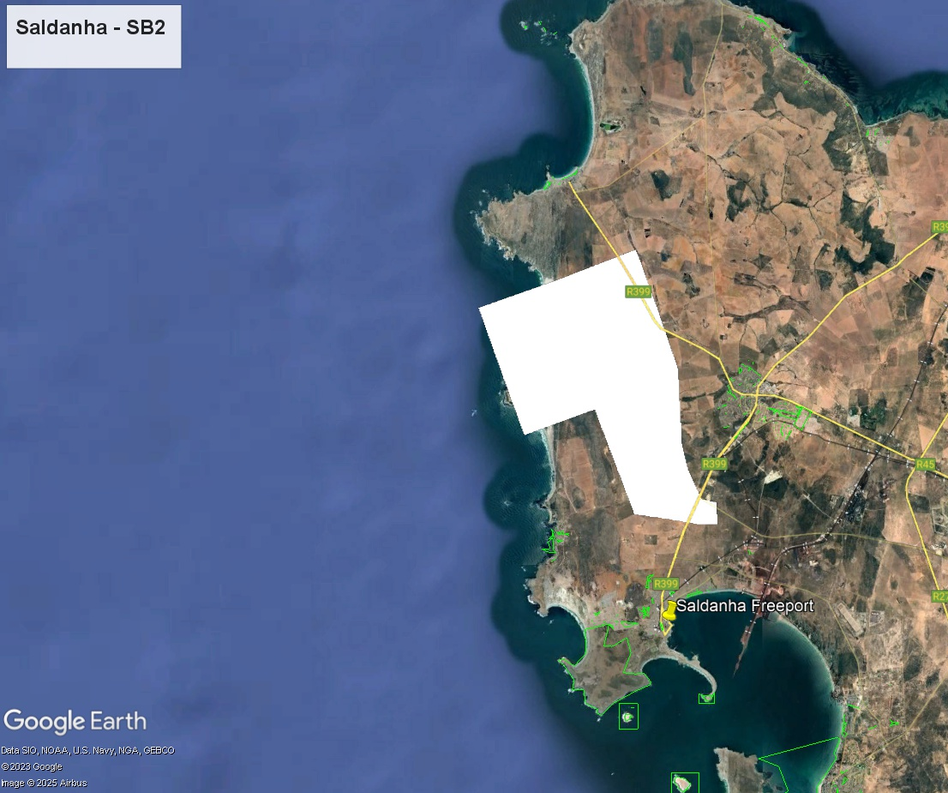
Review of Saldanha
Key highlights of scoring
Well-located in terms of 2 hours from CPT CBD/airport
Existing and functional SEZ
Airport in Saldanha FASD with hangarage and facilities
Commercial industry potential in area for operators
Complex, restricted airspace (SAAF) with National Key Points
Coastal location allows for future options for expansion over the ocean (may have other restrictions)
Second option north of Elandsbaai with adjoining corridor to avoid major airspace congestion and presence of protected areas and ‘critical biodiversity areas’
Final Score & Ranking | 4.10 | 1
Scoring elements summary
1 Airspace | 2 Security | 3 Infrastructure | 4 Future growth | 5 UAS Industry | 6 Community | 7 Environment | 8 Regulatory | 9 R&D access | 10 Domestic & FDI
0.93 | 1.00 | 0.60 | 0.38 | 0.40 | 0.26 | 0.10 | 0.20 | 0.15 | 0.08

Slide 20
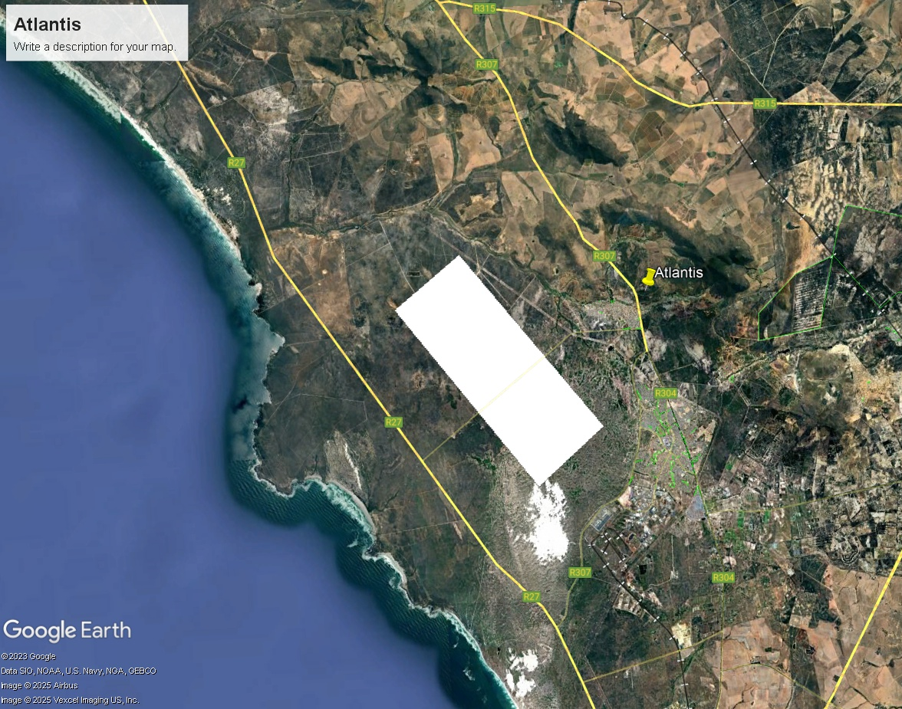
Review of Atlantis
Key highlights of scoring
Well-located in terms of 1.5 hours from CPT CBD/airport
Existing and functional SEZ with ample space for expansion
Nearby airport Morningstar (private)
Proximity of Koeberg Nuclear Power Station (NKP and airspace) and Ankerlig Power Station
Atlantis sand dunes biosphere area (extends to Darling)
Final Score & Ranking | 3.39 | 4
Scoring elements summary
1 Airspace | 2 Security | 3 Infrastructure | 4 Future growth | 5 UAS Industry | 6 Community | 7 Environment | 8 Regulatory | 9 R&D access | 10 Domestic & FDI
0.93 | 0.40 | 0.57 | 0.35 | 0.40 | 0.26 | 0.08 | 0.20 | 0.15 | 0.05

Slide 21
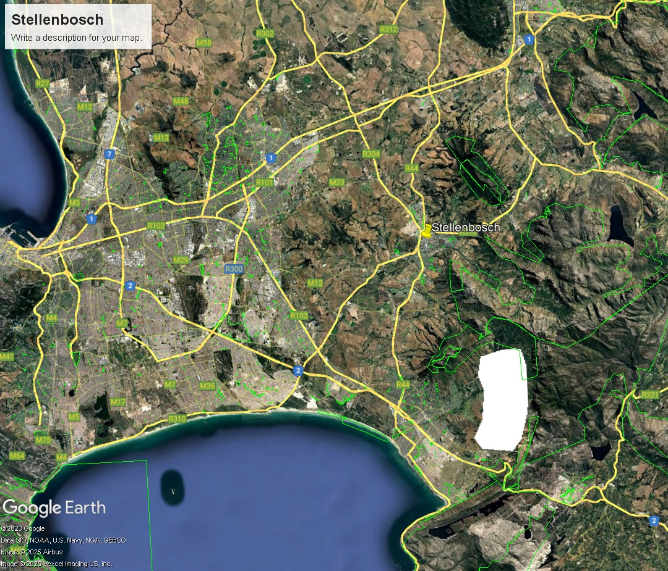
Review of Stellenbosch
Key highlights of scoring
Well-located in terms of <1 hour from CPT CBD/airport
Congested airspace with limited expansion capability
Excellent access to university and R&D
Extensively built-up suburban area & infrastructure
Risk due to proximity to mountains
Potential for community privacy and noise issues
Major biodiversity risks (national parks, protected areas)
Final Score & Ranking | 2.54 | 6
Scoring elements summary
1 Airspace | 2 Security | 3 Infrastructure | 4 Future growth | 5 UAS Industry | 6 Community | 7 Environment | 8 Regulatory | 9 R&D access | 10 Domestic & FDI
0.65 | 0.40 | 0.51 | 0.26 | 0.27 | 0.11 | 0.06 | 0.10 | 0.11 | 0.07

Slide 22
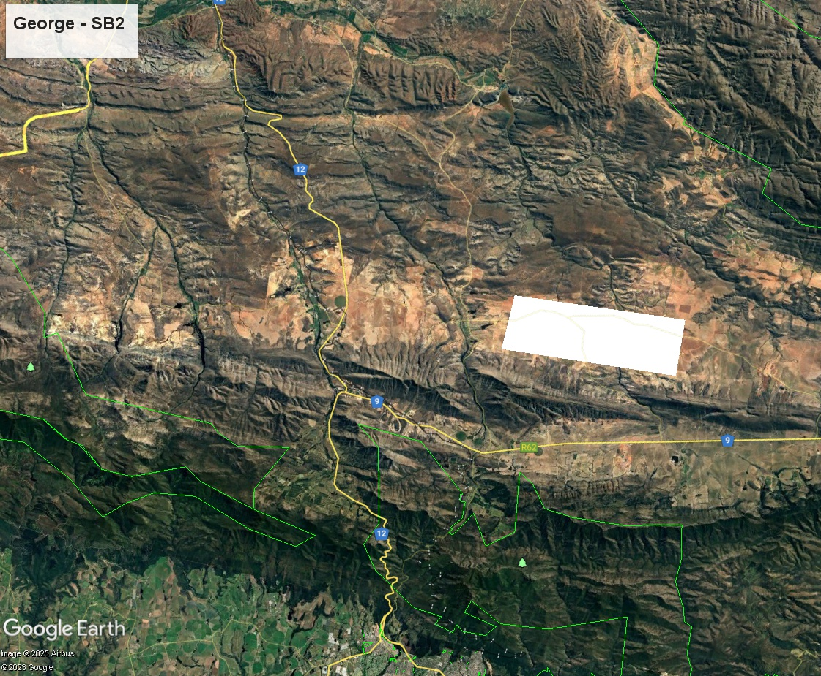
Review of George (SE of Oudtshoorn)
Key highlights of scoring
Recommended site SE of Oudtshoorn (close to Outeniqua mountain range)
Location < 1 hour from George yet > 5 hrs from CPT/airport (limited access for most CPT users)
Some airspace risks due to George TMA
Utility access potentially challenging
Quite scalable
Final Score & Ranking | 3.67 | 3
Scoring elements summary
1 Airspace | 2 Security | 3 Infrastructure | 4 Future growth | 5 UAS Industry | 6 Community | 7 Environment | 8 Regulatory | 9 R&D access | 10 Domestic & FDI
0.93 | 1.00 | 0.34 | 0.49 | 0.16 | 0.21 | 0.20 | 0.20 | 0.10 | 0.05

Slide 23
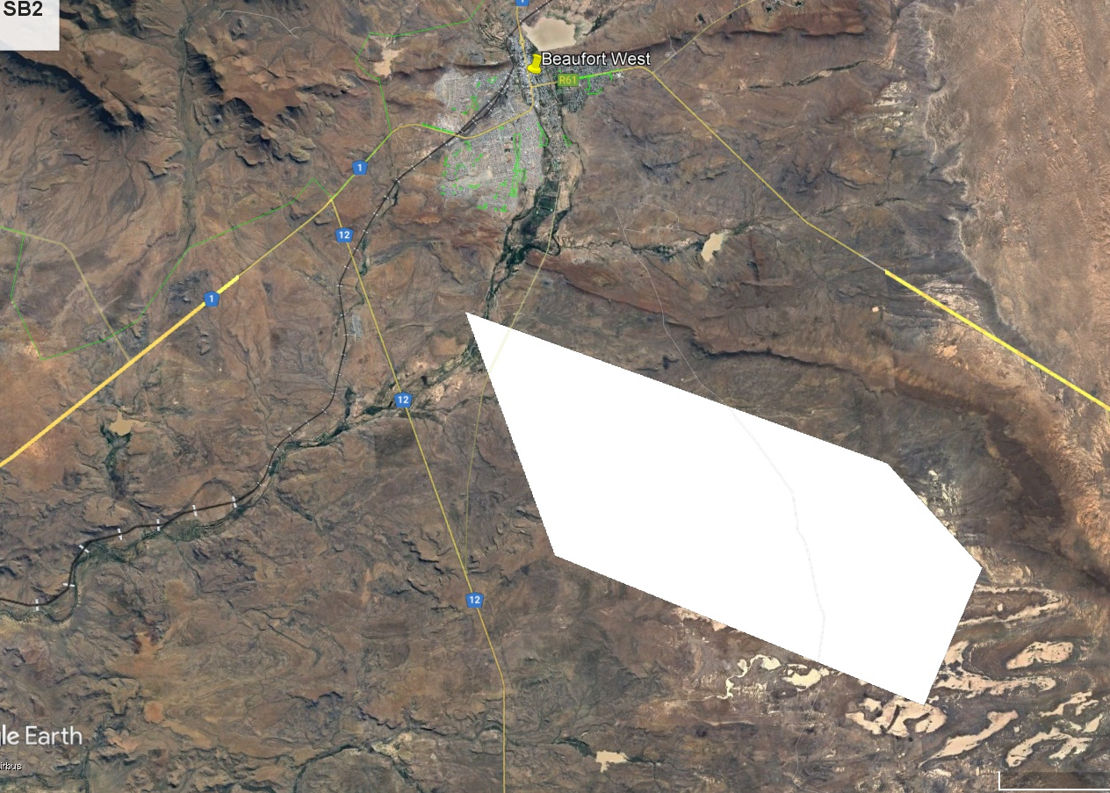
Review of Karoo – Beaufort West
Key highlights of scoring
Sterile airspace with existing airport FABW with good facilities – but located in FAD29
5+ hours from CPT CBD/airport – far for most CPT users
Terrain hostility and accessibility potentially challenging
Access to utilities potentially challenging
Scalable ground footprint
Final Score & Ranking | 3.92 | 2
Scoring elements summary
1 Airspace | 2 Security | 3 Infrastructure | 4 Future growth | 5 UAS Industry | 6 Community | 7 Environment | 8 Regulatory | 9 R&D access | 10 Domestic & FDI
0.95 | 1.00 | 0.38 | 0.38 | 0.40 | 0.23 | 0.23 | 0.15 | 0.15 | 0.04

Slide 24
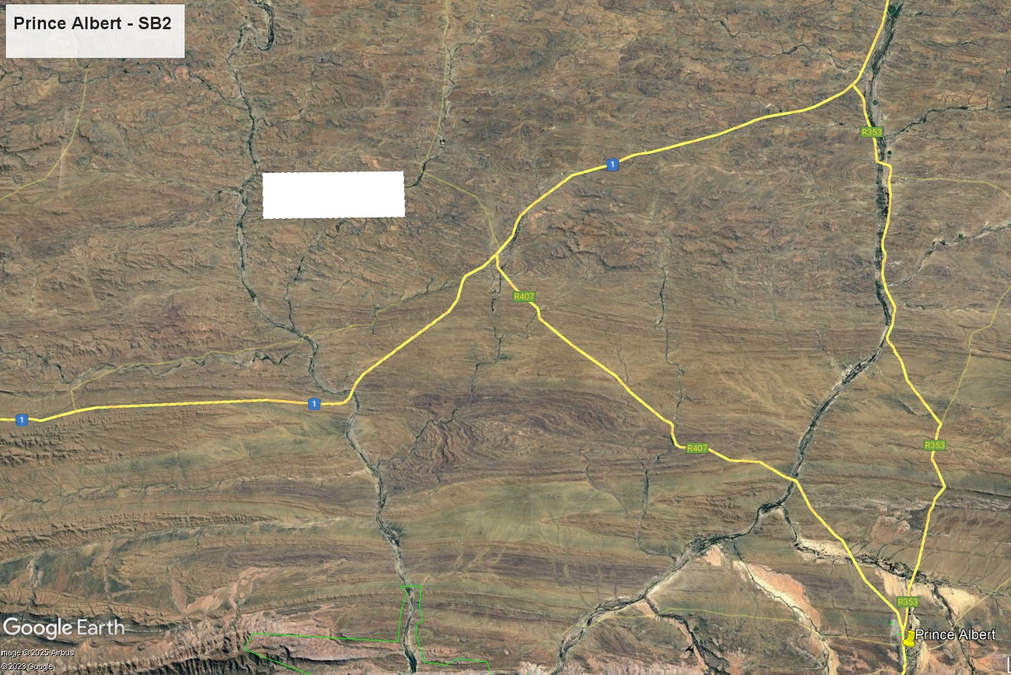
Review of Karoo – Prince Albert
Key highlights of scoring
Sterile airspace with existing airport
4+ hours from CPT CBD/airport – far for most CPT users
Attractive town with amenities
Terrain hostility and accessibility potentially challenging
Access to utilities potentially challenging
Far from User Base
Highly scalable
GIS image Map of area
with coordinates of recommended site
Final Score & Ranking | 3.23 | 5
Scoring elements summary
1 Airspace | 2 Security | 3 Infrastructure | 4 Future growth | 5 UAS Industry | 6 Community | 7 Environment | 8 Regulatory | 9 R&D access | 10 Domestic & FDI
0.85 | 0.80 | 0.27 | 0.48 | 0.18 | 0.21 | 0.23 | 0.10 | 0.08 | 0.04

Slide 25
Summary 6 Site Locations
Site-specific
Analysis
1
2
3
4
5
6
4
Saldanha
Site location: north of Saldanha Bay
Karoo
Beaufort West
Site location: NW of BW
George
Site location:
North of George
Atlantis
Site location:
W of Atlantis SEZ
Karoo
Prince Albert
Site location: 7km W of PA
Stellenbosch
Site location:
E of Somerset West
Score: 4.10
Score: 3.92
Score: 3.67
Score: 3.39
Score: 3.23
Score: 0.00
Safety
risk
POTENTIALLY VIABLE
POTENTIALLY VIABLE
POTENTIALLY VIABLE
MODERATELY VIABLE
MODERATELY VIABLE
NOT
VIABLE
Cautions
& concerns
Airspace, minor env risk, vertical scalability
CPT proximity, utilities, user attractiveness, remoteness
CPT proximity, utilities, user attractiveness, remoteness
Airspace, ground hazards, minor env risk, vertical scalability
CPT proximity, utilities, accessibility, user attractiveness, remoteness
Proximity to nature reserves makes a sandbox unviable, unscalable

Slide 26

Initial Institutional Arrangements

Slide 27

Initial Institutional arrangements
Institutional arrangements
1
2
3
4
5
6
Ownership Model
Governance structure
Regulatory environment & compliance
IMPLEMENTATION MODEL
5 Operating Models
Learnings from the international case studies
Operational Model
&
Concept of Operations (CONOPS)
Daily management &
stakeholder engagement
Commercial growth
&
industry needs
Phased evolution

Slide 28
Five Operating Models
International Case Study Insights
Institutional arrangements
Aviation Authority Designated Sites | Province/ State-Led UAS Test Sites | Private Sector-Led Model | Collaborative Governance Model | Sovereign Governance Model
Government-backed aviation authority developed programmes in line with and to inform evolution of national UAS framework | Regional governments lead governance and funding Strong PPP | Led by industry consortia with aviation authority oversight, public funding & alignment with national UAS frameworks | Aviation authority provides oversight. Operations involve multi-stakeholder governance Strong PPP | Led by sovereign entity with independent regulatory influence. Strong integration of community & economic goals
FAA UAS Test Sites Programme (2014 - 2017) FAA UAS Integration Pilot Programme (2017 – ongoing) FAA Beyond Programme (2020 – ongoing) | Northern Plains UAS Test Site (USA) Established 2014 now operates as a test site and regulatory enabler with state-wide BVLOS ops Economic development focus | Project Skyway (UK). Privately developed dedicated BVLOS corridor, with cloud based UTM Commercial and market driven focus | Swiss U-Space Aviation regulators and UTM tech. companies Digitally governed collaborative model for safe UAS integration Urban focus | Choctaw Nation Drone Corridor (USA) Balances FAA compliance with tribal autonomy BVLOS infrastructure tailored to regional needs
Structure
Examples

Slide 29
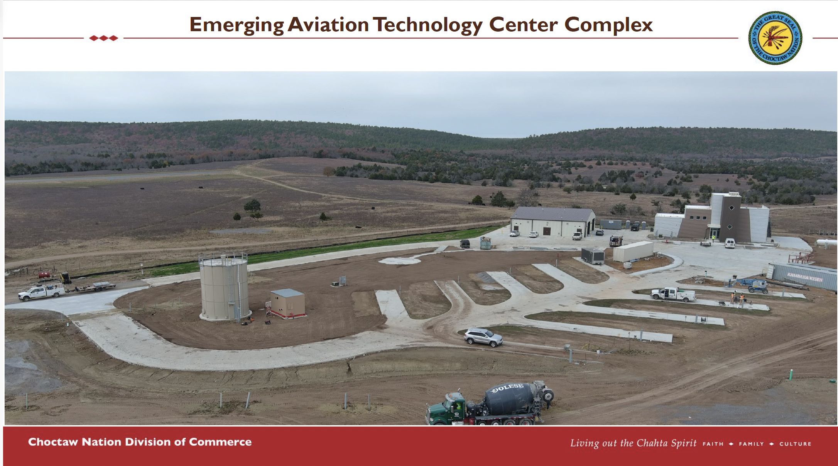

Slide 30
Institutional Arrangements
Institutional arrangements
Ownership Model
Governance Structure
Regulatory Environment & Compliance
Phase 1: Public sector leads. Full ownership by WCG for regulatory/industry trust
Multi-sector governance framework integrating public, private & regulatory bodies
Aviation Compliance
Alignment with SACAA and ATNS regs & requirements
Phased, risk-based expansion of BVLOS operations
Key bodies
Steering Committee
Technical Advisory Board
Operational Management Team
Regulatory Advisory Board
Industry & Community Engagement Forum
Non-Aviation Compliance
Land use & zoning
Environmental compliance
Safety & security
Phase 2: Transition via PPP. Industry assuming increasing operational responsibilities
Early regulator engagement
Ensures seamless integration into national airspace
Streamlines ops approvals
Facilitates permitting processes
Ensures balanced decision-making, strategic oversight & alignment with regulatory authorities
Phase 3: Private leadership with public oversight ensuring strategic compliance & sustainability

Slide 31
Operational Model & Concepts of Operations
Institutional arrangements
Initial Phase – VLOS & EVLOS
BVLOS with Ground Based Detect & Avoid (DAA)
Fully Integrated BVLOS – Hybrid Systems
Visual Line of Sight (VLOS)/ Extended Visual Line of Sight (EVLOS)
Below 400 ft above ground level (AGL)
Basic & daytime operations
Visual observers & basic tracking
Geofencing and segregated airspace
Compliance data logging
Risk based expansion to Beyond Visual Line of Sight (BVLOS)
Below 1000 ft AGL
Complex & nighttime ops
Improved infrastructure & specialist support
Utilising hybrid, ground or on-board based DAA tech
Real-time compliance and data transmission
Fully operational drone corridor
Utilising hybrid, ground or on-board DAA tech for dynamic BVLOS ops
Full Unmanned Traffic Management-Air Traffic Management (UTM-ATM) coordination for unmanned & manned aviation
Scalable infrastructure to support Advance Air Mobility (AAM)
Testing facilitation and support will follow a structured, risk-based approach across the phases, evolving from basic VLOS operations to enable full BVLOS and UTM-ATM integration

Slide 32
Implementation Model
Daily Management & Stakeholder Engagement
Institutional arrangements
Operational Management Team Structure
Daily Management & Engagement
Director of Operations
Industry & Community Engagement Forum
Sandbox
Operational Management Team
  Host regular engagement sessions
  Gather feedback for operational improvements
Director of Safety & Compliance
Continuous Improvement & Sustainability
Exec Director
Sandbox
Key Functions:
Scheduling & logistics;
compliance monitoring;
data reporting; & performance tracking
  Regular audits and KPI tracking
  Incorporate insights from the community and industry partners
  Update operational with new tech and evolving regulations
Regulatory Liaison Unit
Director of Stakeholder & Community Engagement
Regulatory Advisory Board
  Facilitate BVLOS approvals
  Ensure continuous regulatory compliance
  Provide updates on evolving aviation standards
Chief Business Officer & Economic Development

Slide 33
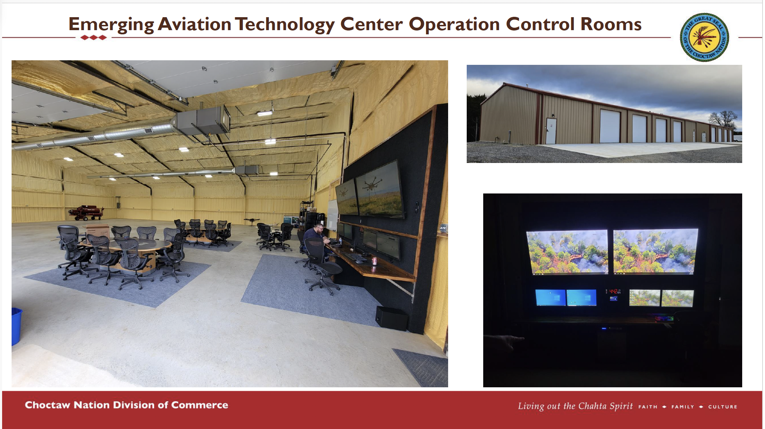

Slide 34
Implementation Model
Commercial Growth & Industry Needs
Institutional arrangements
Phase 1: Industry Engagement & Local Development
Phase 2: Scaling Commercial Operations & Partnerships
Phase 3: International Integration & Aviation Network Expansion
Attracting local drone operators, service providers and research institutions
Encouraging early-stage testing & prototype validation
Encouraging community and public service supporting applications
Expanding industry participation through R&D collaborations & sandbox trials
Facilitating private sector investment through commercial testbed
Developing regulatory pathways and support for commercial drone ops
Establishing international partnerships and testing collaborations
Positioning the sandbox as a regional hub for drone tech innovation
Enabling foreign direct investment into the drone sector

Slide 35
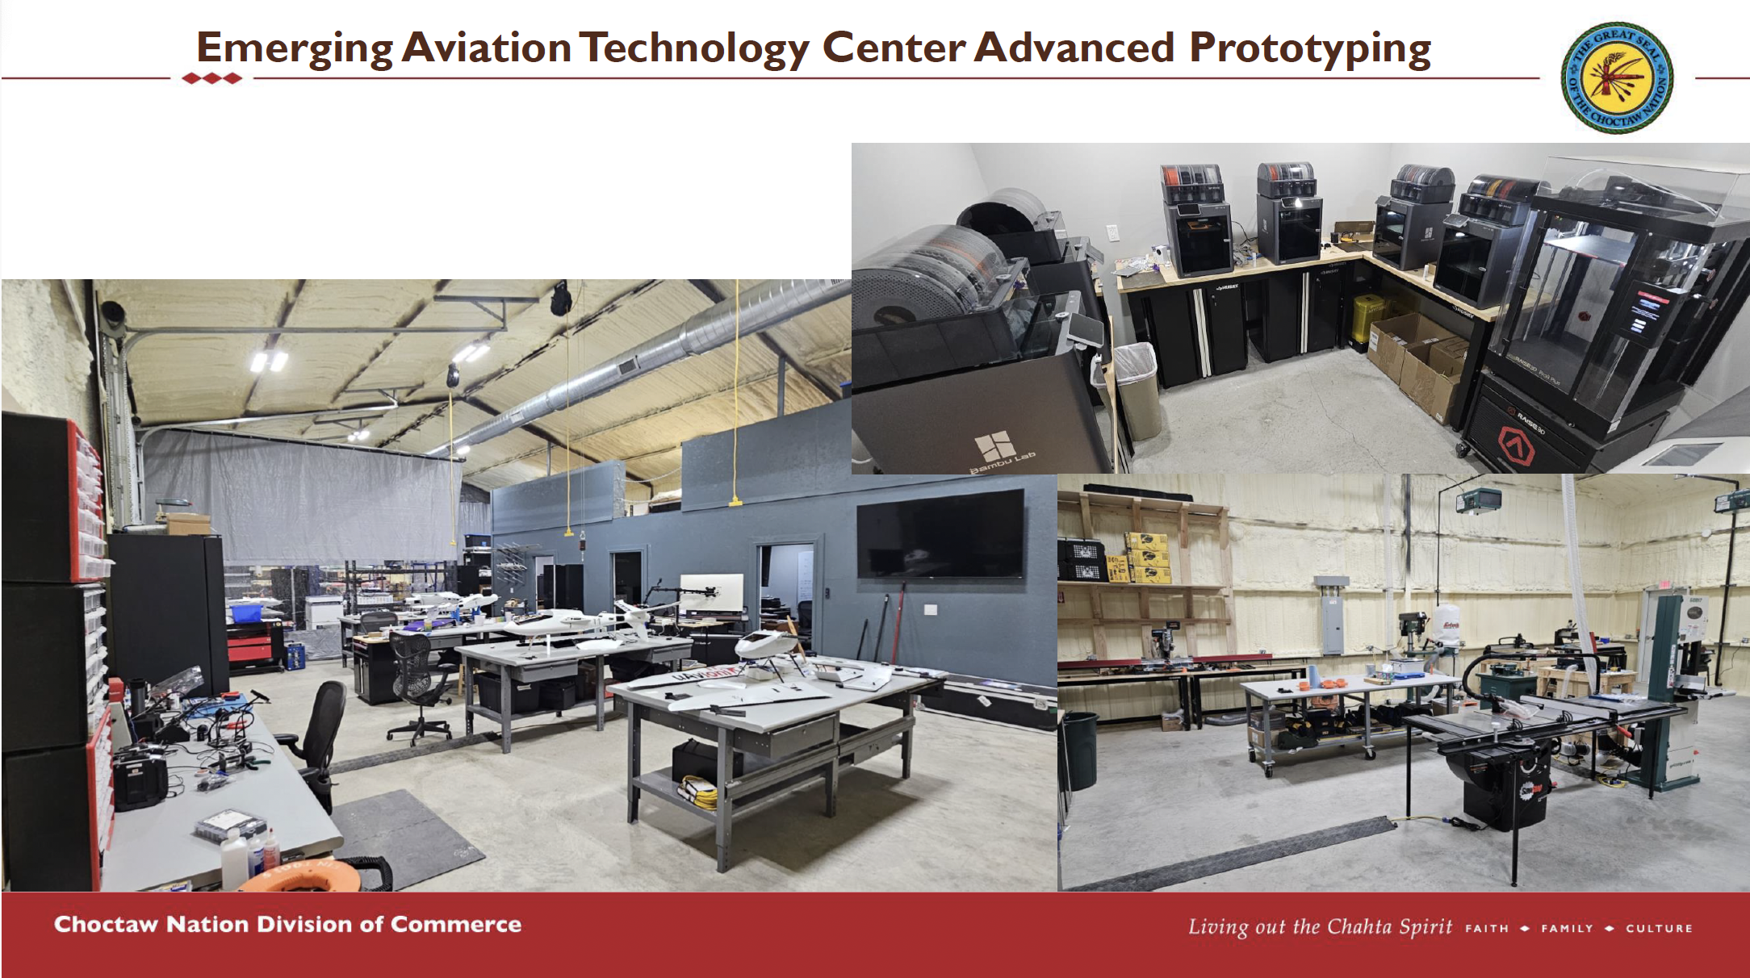

Slide 36
Implementation Model
Phased Evolution
Institutional arrangements
Initial Phase – Public Leadership & Establishment
Transition to PPP & Expansion
Full Maturity with Private Leadership & Public Oversight
Governance
WCG-led
Multi-stakeholder Steering Committee
Ownership
WCG retains full control of infrastructure & compliance
Operations
VLOS/ EVLOS
Below 400 ft AGL
Basic & daytime ops
Small footprint
Governance
Broader industry participation
Regulatory integration
Ownership
Gradual transfer of operational responsibilities to private partners
Operations
BVLOS
Below 1000 ft AGL
Complex & night ops
Larger footprint
Infrastructure & specialist support
Governance
Industry-led operations under WCG’s strategic oversight
Ownership
Private sector assumes control
WCG retains strategic assets
Operations
Fully operational drone corridor.

Slide 37

Initial Regulation Sandbox Approval Process

Slide 38



Aviation Assumptions
Phased
Approach
Ground & Airspace Requirements
Futureproofed airspace management
  Air Traffic Navigation Services (ATNS) is moving towards Dynamic Airspace
  Unmanned Traffic Management (UTM) to be incorporated in Sandbox planning
  A digital governance framework – e.g. including automated approvals, remote ID and dynamic UTM integration - is required for safe and scalable drone operations
Incorporate International Best Practice
Beyond Visual Line of Sight (BVLOS) is required to scale and must be supported by dynamic airspace solutions, automated deconfliction and digital regulatory tools
Initial Development of a Drone Sandbox
For the initial development and to expedite the establishment process – Flexible Use Airspace (FUA). As per international sandboxes a structured risk-based approval framework is proposed for progression from testing to full integration
Commercial Application
Sandbox activities must be designed with clear industry use cases, investment viability and commercialisation pathways
01
02
03
04
Aviation

Slide 39
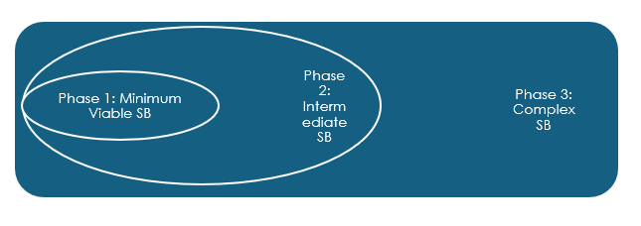
Phased Approach Parameter Summary
Phased
Approach
Phase 1
Minimum Viable Operational Sandbox
Phase 2
Intermediate Sandbox
VLOS/EVLOS
<400ft AGL
Day Ops
Basic Operations
Small Footprint
Basic Infrastructure
BVLOS
<1,000ft AGL
Day & Night Ops
Advanced Operations
Larger Footprint
Specialised Infrastructure
Technology & Digital Tools
Specialists
Phase 3
Complex Sandbox
Intermediate Sandbox
Intermediate Sandbox
Fully operational drone corridor for complex UAS & RPAS operations
Corridor
Aviation

Slide 40



Initial Regulatory Considerations & Requirements
Regulation Sandbox
Approvals
Zoning
Aviation Regulatory Impact
Municipal By-laws
10
1
Airspace Allocation & Management
9
2
Liability & Insurance
International Standards & Best Practice
8
3
3 Key Enablers
Aviation permissions
Stakeholder/community
engagement
3. Environmental & zoning issues
7
4
Privacy & Data Protection
Stakeholder engagement
6
5
Community Impact/
Public acceptance
Environmental Impact

Slide 41
Regulatory sandbox key questions
Regulation Sandbox
Approvals
1
How do we create a regulatory sandbox?
What are the required regulatory issues that need to be addressed?
How do we identify and request airspace for the sandbox?
How do we ensure sandbox operations are safe and compliant?
How do we promote airspace integration towards large-scale UAS adoption?
How do we ensure that sandbox trials find commercial success?
2
3
4
5
6

Slide 42
Aviation Regulatory Sandbox Model
Regulation Sandbox
Approvals
Structure
Key Role in Regulatory Process
UAS-SB-TF
SACAA, ATNS, CSIR & WCG
Advisory
Regulatory Guidance & Oversight
Approvals & Exemptions
Regulatory bodies (SACAA, DOT & ATNS) retain final authority for approvals and exemptions
Sandbox-Specific
Operations Specification (OpSpec)
Sandbox data informs evolving exemption criteria
Regulatory
SACAA
DoT
ATNS
Steering Committee
WCG
Tech Advisory Board
WCG Governance
Internal Authorizations
Operational Management Team oversees case-specific trial applications within defined regulatory parameters
Trial specific authorizations
Engagement Forum
Sandbox: Operational Management Team
Regulatory Advisory Board
Sandbox User
Sandbox Participant
Sandbox Participant
Sandbox operational/ data feedback for trial analysis to help inform regulatory processes.
Aviation
Aviation
Trial #1
Trial #1

Slide 43
6 Key Steps for a Successful
WC Regulatory Sandbox
Regulation Sandbox
Approvals
1
Formalise a collaborative framework Task Force [UAS-SB-TF]
2
Address the overlying national airspace issues
3
Integrate exemptions & alternative means of compliance
4
Create a Sandbox Experimental Test Flight Authority
5
Introduce sandbox UAS management
6
Develop an integration & commercialisation process
Aviation

Slide 44
1
Formalise a collaborative framework
Task Force [UAS-SB-TF]
Regulation Sandbox
Approvals
Core Objectives
Build an enabling environment for the regulatory UAS sandbox development with specific actions towards streamlining regulatory processes for the success of the sandbox
Create a framework for the successful development of the UAS industry by leveraging the sandbox to address industry developmental issues
Identify key collaborative and strategic partnerships towards the success and inclusive economic development of the UAS sandbox and the industry
Measure of Success
The UAS-SB-TF is formed with agreed-upon Terms of Reference, sets up and meets regularly and oversees the required aviation elements to develop and make the WC regulatory sandbox a success.
Aviation

Slide 45
2
Address the overlying national airspace issues
Regulation Sandbox
Approvals
Growth of the UAS sector and and increasing demand on the Air Traffic
Management (ATM) system to optimise use of available airspace
WC Regulatory Sandbox will provide proof of concept for the dynamic application, coordination and establishment of future sandboxes / test sites within South African airspace
The development, testing and deployment of UTM technology supporting seamless UAS integration within South African airspace. As regulatory adaptation is data driven, sandbox operational data will continuously inform national regulatory evolution through the UAS-SB-WG.
A key requirement is defined in ICAO Doc 9854, Global Air Traffic Management Operational Concept (GATMOC) – “all aircraft will be known to the Air Traffic Management (ATM) system.”
WC sandbox is the pilot project for testing the requirements of the ATNS AIC
Measure of Success
ATNS AIC is approved by NASCOM and included in the sandbox as a standard and pilot for testing. This becomes the national standard for sandboxes in South Africa, serving as a benchmark for data-driven regulatory evolution and policy updates.
Aviation

Slide 46
3
Integrate Exemptions and Alternative Means of Compliance
Regulation Sandbox
Approvals
Exemption (SA Civil Aviation Regulations, Part 11)
An exemption is an application to deviate from specific Civil Aviation Regulation requirement(s)
Approval is subject to the terms and conditions specified by the CAA, including the maximum validity period which may not exceed 1 year.
Regulatory sandboxes benefit from a digitalised and automated process for exemption requests, faster approvals, iterative regulatory adaptation and improved compliance tracking.
Digitalised processes can also support real-time monitoring of exemption usage providing data-driven insights that inform regulatory updates and risk-based compliance adjustments.
Alternative Means of Compliance (SA Civil Aviation Regulations, Part 11)
An application submitted for recognition of alternative means of compliance, may be approved by SA CAA if, on good cause shown, the SA CAA is satisfied that aviation safety will not be jeopardised.
Measure of Success
SACAA approves Exemption and/or Alternative Means of Compliance applications to fast-track the implementation of the WC Regulatory Sandbox until a broader regulatory amendment is completed and the use of digital tools for real-time exemption tracking and automated compliance reporting is implemented.
Aviation

Slide 47
4
Create a Sandbox Experimental Test Flight Authority
Regulation Sandbox
Approvals
With reference to the Technical Guidance Material (TGM) for RPAS Proving Flight Authorization (18 July 2022) published on the SACAA website.
Purpose: to provide procedural guidelines to applicants regarding the process and data required for an UAS Proving Flight Authorization – currently only UAS designers and manufacturers can apply.
Strict Requirements include a Certificate of Registration from SACAA; Pilot licensing; System Safety Assessment and Airspace approvals which are costly and time-consuming.
Validity: Issued on a case-by-case basis for a period determined by the SACAA.
Measure of Success
Simplify and streamline the current Proving Flight Authorization process to prevent bottlenecks. Include UAS and related technology/equipment testing by participants other than designers and manufacturers.
Aviation

Slide 48
5
Introduce Unmanned Traffic Management (UTM)
Regulation Sandbox
Approvals
Why UTM?
Requiring Air Traffic Controllers to coordinate and manage separation between aircraft and drones via voice-communication is not an option and prohibits safe airspace integration of UAS at scale.
What is UTM?
Unmanned Traffic Management is a digital system that coordinate and manage drone operations in shared airspace (similar to how Air Traffic Controllers would manage aircraft). Communication is through a network of digital systems (air, ground or space-based communication, navigation and surveillance).
WC Sandbox is the pilot project for testing UTM CONOPS and system requirements, including digital governance tools, automated approval systems and integrated UTM-ATM systems.
Measure of Success
An operational and strategic plan for the introduction of UTM into the sandbox as a testing space for the digital systems for the future, with key milestones towards long-term integrated traffic management.
Aviation

Slide 49
6
Develop an Integration & Commercialisation Process
Regulation Sandbox
Approvals
International regulatory sandboxes demonstrate that commercialisation success depends on a structured regulatory pathway with clear predictable certification standards.
Aviation policy refinement and regulatory amendment urgently needed to remove barriers which adversely affect successful sandbox trials finding adoption and implementation at scale outside the sandbox environment.
Barriers to entry
Although compliance with stringent requirements of Part 101 enables complex and high-risk operations, application is costly, time-consuming and requires aviation expertise.
Too restrictive for individuals, start-ups and SMMEs to achieve even for low-risk type operations.
A risk-based regulatory approach (Categorization) is encouraged by ICAO – but the requirements of the Air Services Licensing (ASL) Act will delay adoption of this risk-based approach.
Safety buffer zone is required: UAS at <400ft AGL and aircraft at >500ft AGL.
Measure of Success
Removal of the Air Service License requirement for UAS operators and adoption of the Categorization Model.
Flights <400ft AGL to be ‘reserved’ for low-altitude UAS operations in line with ICAO Annex 2. Success will be measured through phased certification pathways and commercialisation incentives.
Aviation

Slide 50
Next Steps and Suggested RACI Matrix
Regulation Sandbox
Approvals
Agree to the formation of the UAS-SB-TF
Internal discussions towards the recommended WC Regulatory Sandbox framework
Confirm two next meetings – 5 March (Wed) and 12 March (Wed)
Request for CSIR to Chair the UAS-SB-TF
 | UAS-SB-WG Activities | WC-RSB Phase 1 | WC-RSB Phase 2 | WC-RSB Phase 3
1 | Formalise a collaborative framework UAS Sandbox Task Force (UAS-SB-TF)
2 | Address national airspace issues (Draft AIC)
3 | Integrate Exemptions / Alternative Means of Compliance
4 | Create a Sandbox Experimental Test Flight Authorization (Proving Flight Authority)
5 | Introduce WC Sandbox UTM Detect and Avoid testing Electronic Conspicuity testing UTM technology implementation
6 | Develop an Integration & Commercialisation Process ASL 2) Flights <500ft AGL 3) ADS-B Mandate
Aviation

Slide 51

Initial Financial Models for a Minimum Viable Sandbox

Slide 52

Initial financial model approach
Financial
models
Complex infrastructure project require a multi-layered approach
  Multiple business models need to be developed – WCG Sandbox, User Business Case, ATNS, SACAA
  Focus on WCG Sandbox – viability to project sponsor is critical
Incorporate International Best International Practice
Bring in learnings from other sandboxes/corridors around the world
Understand and incorporate local situational elements
South Africa is a developing country with socio-economic issues that differ to other sandboxes around the world (issues of relevance and replicability)
Commercial Application
Final results must be grounded in commercial viability elements
The goal is what goes into the sandbox must come out and apply in the regulatory and commercial sector
01
02
03
04

Slide 53
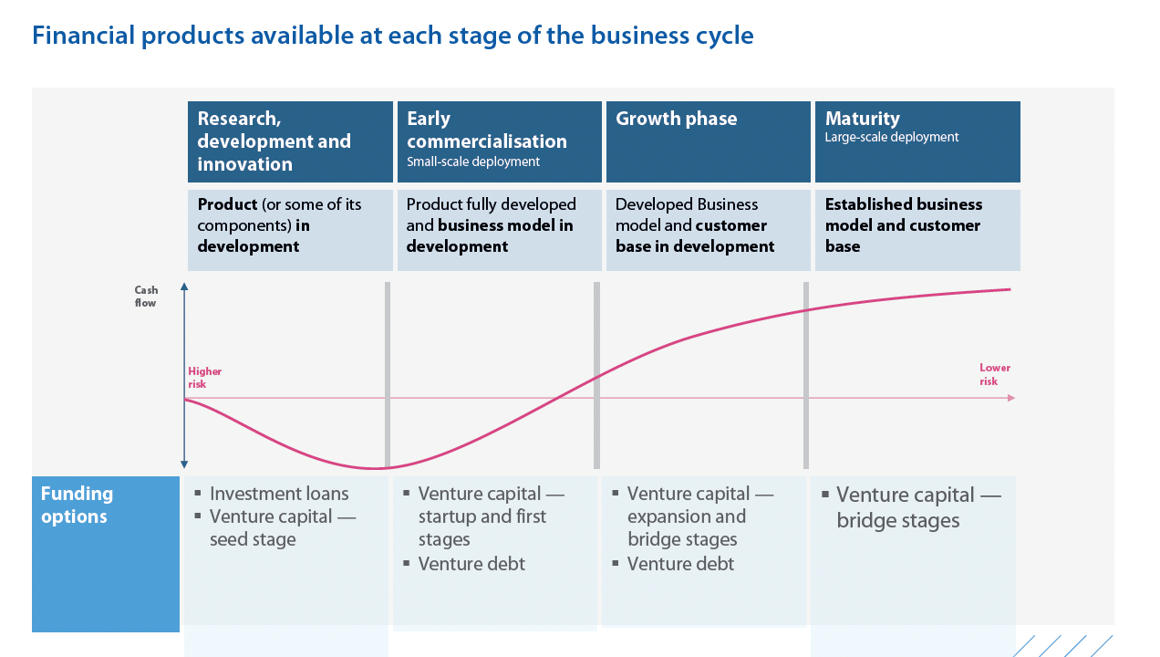
Financial products available in business cycle
Financial
models
Source: 2023 European Investment Bank (EIB) Guide to finance for drone projects

Slide 54
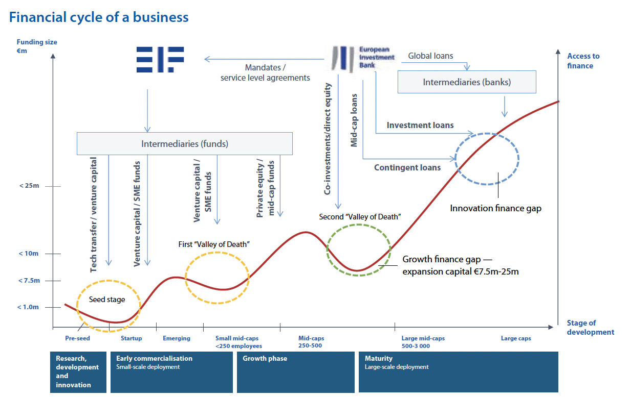
Financial cycle of a business
Financial
models
Source: 2023 European Investment Bank (EIB) Guide to finance for drone projects

Slide 55
Financial model framework: Costs
Financial
models
Main categories | Sub-categories | Way forward questions to address
Planning costs | Re-zoning (if required) and facilitating public participation. Environmental impact assessment (if required) to get Record of Decision. Other possible impact studies (e.g. Transport Impact Assessment). Bulk infrastructure design and costing (if required) (energy, water, waste). Start-up / phase 1 digital equipment specifications and costing. Legal costs for proposed / customised sandbox regulations as well as for institutional design and establishment and registration Other specialised studies required ((e.g. develop a business plan and/or cost-benefit impact study, develop marketing strategy?)
Initial establishment-start-up costs Year 1 | Site preparation required (e.g. vegetation and earth clearing etc.) Physical and digital infrastructure for testing, including airspace management systems, communication networks, and data Staff operations for Sandbox services Physical building(s) for staff, ICT equipment, and customer equipment Transport infrastructure (e.g. roads) Bulk infrastructure: Energy supply, water supply, sewerage and waste. Drone and other equipment. Software required/ licensing. Marketing costs Staff training for start-up operations. | Number of buildings, type/ level of facilities, sizes of facilities Will site need any road transport upgrades? Will site need any new bulk and/or connecting infrastructure? Will any shared equipment and/or software for users be provided as part of their testing/ piloting- e.g. sensors, data recording etc.? What core staff and training required
Ongoing operational costs | Staff employment costs Fibre Municipal rates and services (incl. water and electricity). | How will operating costs be recouped (e.g. fibre, staffing, software etc.) (i.e. the operating model and institutional arrangements).
Phase 2 expansion / upgrade costs | Physical and digital infrastructure expansion/ upgrades for testing, including airspace management systems, communication networks, and data collection Ongoing staff training programme

Slide 56
Financial model framework: Revenue and broader socio-economic benefits
Financial
models
Main categories | Sub-categories |  |  | Way forward questions to address
Sandbox revenue |  | Informed by recommended pricing approach and structure (see options to the right). Possible revenue streams based on identified demand: Sandbox services Application and testing fees to relevant authorities | Pricing approach options: Cost-Sharing Models Fixed Pricing Structures Performance-Based Incentives Subscription or Membership Fees Tiered Pricing Based on Service Levels Grants and Funding Opportunities
Broader socio-economic benefits/ impacts to note should a full cost-benefit or economic impact assessment be required if appropriate |  | Potential broader benefits (re cost-benefit and business case): Site preparation jobs e.g. site clearing (could be EPWP jobs for alien vegetation?) Direct construction jobs Operating jobs Tax revenues SMME development/ supplier opportunities Transformation/ inclusive opportunities: staff profile and training Private sector investment and value chain development (and knock-on job creation development from accelerated investment and production of new technologies confirmed viable etc): Access to R&D funding for firms using the sandbox Ability to raise commercial finance for manufacturing product development

