Slide 1
Mobility Department project assessment
Against DoI’s “panoptic principles”
September 2025

Slide 2
Background and introduction
  As part of the Draft WC Infrastructure Strategy (WCIS) 2050, DoI and WCMD have shortlisted projects to be pursued for infrastructure funding.
  Shortlisted Mobility projects are:
    Shayela Smart: Suite of minibus taxi (MBT) improvement and transformation interventions
    GIPTN: ‘Infrastructure-light’ bus service in George
    Rural intertown transport solution: Scheduled intertown MBT service
    NMT demonstration town: NMT improvement initiatives consolidated in one town to demonstrate impact
    Park and Ride: Pilot park and ride facilities / services to test concept and support decongestion
    eMBT Pilot: Piloting of electric minibuses under real-world conditions, in commercial service, across the Western Cape, to support the transition of the MBT sector nationally towards e-mobility
    Freight Rail Revitalisation: Initiatives to enhance regional rail connectivity, promote private sector investment, and support the revitalisation of branch lines and key regional freight corridors.
  These shortlisted projects are to be assessed against the WCIS’s ‘panoptic principles’
    The aim of this process is to determine projects that are “business-case ready” and eligible to form part of a “bankable, investor-ready” project pipeline

Slide 3
WCIIP 2050 | Project Pipeline Evaluation
Panoptic Scoring Model

Slide 4
WCIIP 2050 | Project Pipeline Evaluation
Panoptic Scoring Model

Slide 5
Shayela Smart

Slide 6
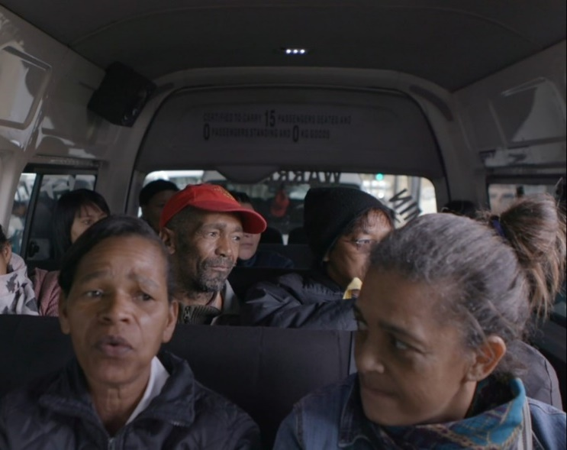




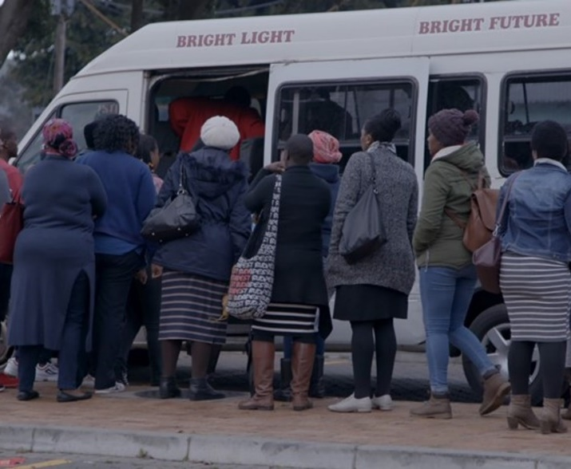

Shayela Smart
Overview
Shayela Smart is a joint initiative between WCG, CoCT and SANTACO WC to incrementally improve, integrate and formalise MBT services over the long-term, strengthen regulation and address key industry issues.
Phase 1 establishes the foundation for long-term reform
Driver registration & training
Raise driving standards and safety
Vehicle tracking & monitoring system
Installation of trackers linked to an operational monitoring system
Vehicle branding
A single brand will be developed and applied to all legal vehicles
PTI capacity measures
Interventions to increase the capacity of key PTIs
Project Status
    Business Plan completed
    Efforts continue to secure funding for implementation

Slide 7
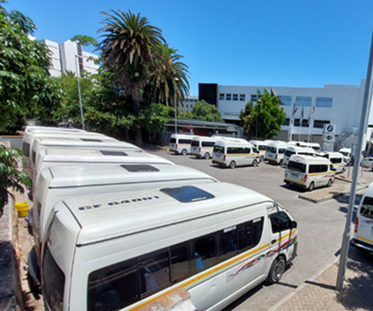
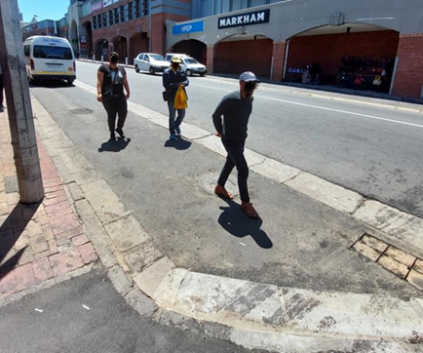
Shayela Smart
Infrastructure requirements and costs
Total programme costs are as follows:
Infrastructure requirements & costs
 | FY 1 (R’000) | FY 2 (R’000) | FY 3 (R’000) | FY4+ (R’000)
Establishment costs | 30 035 | 72 386 | 62 216 | 9 172
Capital costs | 51 540 | 70 859 | 15 848 | 2 824
Operational costs | 51 738 | 76 118 | 107 130 | 123 276
Total | 133 312 | 219 362 | 185 191 | 135 270
Infrastructure will need to be improved to support Shayela Smart
This entails the establishment of remote holding areas (RHA) and strategic stop and go (SS&G) facilities in the Metro to alleviate congestion at priority PTIs
The total infrastructure cost is approximately ~R94 million over the first two financial years:
  Establishment costs include: Systems development; vehicle fitout and branding; industry training
  Capital costs include: Infrastructure and equipment (mobile devices, CCTV cameras, driver tags, vehicle trackers / tag readers)
  Operational costs include: Systems maintenance and support; operational monitoring and support; industry management; driver awards to incentivise good performance; additional provincial staffing capacity to support management of the programme
Project costs will peak in the first three years of implementing the project, and are expected to stabilise at around R135 million per year thereafter
FY 1 (R’000) | FY 2 (R’000) | FY 3+ (R’000)
45 250 | 47 965 | -
RHA
SS&G
Includes infrastructure costs

Slide 8
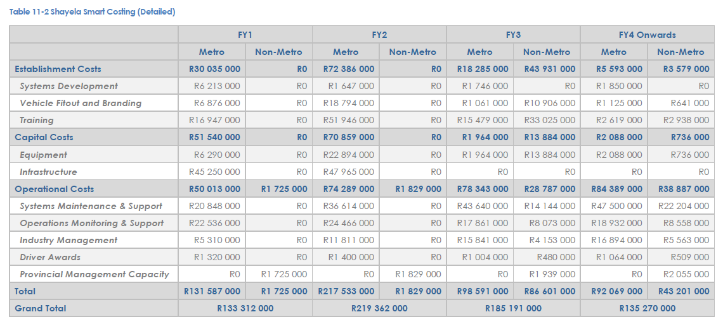
Shayela Smart
Business Plan extract

Slide 9
Shayela Smart | Social & technology infrastructure
Panoptic Principle 1 (PP1): Infrastructure Innovation that Drives Equitable Economic, Social, and Ecological Development
Sub-principle | Relevant prescripts | Assessment question | Project response
PP1.1 Infrastructure Design and Material Innovation Integrate prescribed planning frameworks to promote innovation in infrastructure design, and infrastructure material use aligned to national and local development goals. | NT, MTEF, NDP, NIP, NSDF, NLTF, WCSDF 2035, MSDF, PLTF, PSP 2025-2030, G4J, WCIF, WCEIIF, CC response strategy, Green BCSA, SABS, BSA, NDC, CCA 2024, JTF, WCCCRS. | Does the project offer clear evidence of compliance to design innovations pertaining to key planning prescripts and construction material use across the 3 spheres of government? | Infrastructure supports a new operating model which will enhance operational efficiency, and allow for additional routes to be accommodated, thereby improving accessibility and levels of service for passengers. Incremental and collaborative approach: WCMD is partnering with CoCT and SANTACO WC to roll out Shayela Smart in phases. This type of joint initiative and incremental approach are innovative in MBT reform projects.
PP1.2 ICT Innovation Promote innovation in ICT to enhance ease of doing business and government processes, driving economic and governance efficiencies. | NDP, SITA, G4J, WCIF, PSP 2025-2030, PLTF. | Does the project offer clear evidence of compliance to ICT innovations and/or efficiencies like ease-of-doing-business and/or ease-of-doing-government? | ICT will be leveraged through the installation of vehicle tracking and monitoring software in MBTs. This will improve the WCMD’s ease-of-doing-government by providing detailed data on adherence to legal routes and road safety standards.

Slide 10
Shayela Smart | Social & technology infrastructure
Panoptic Principle 2 (PP2): Innovative infrastructure value chains / ecosystems contribute to building resilient, sustainable, and regenerative systems
Sub-principle | Relevant prescripts | Assessment question | Project response
PP2.1 Resilient Infra. Design and Risk Mitigation Align infrastructure design with resilience principles to address climate change, sustainability, and regenerative practices. It must also address water, energy, and disaster management through proactive risk mitigation strategies and policies. | WCIF, PLTF, NDC, CCA 2024, JTF, WCCCRS, WCEIIF, Green BCSA. | Does the project offer clear evidence of innovations that foster resilience and regenerative aspects of the infrastructure value chain; and are there risk mitigation strategies in place? | Public transport has lower carbon emissions per person than private vehicles because they carry many more people in one vehicle. Public transport services, such as Shayela Smart, support reduced private vehicle use, which helps to address climate change by reducing carbon emissions.
PP2.2 Infra. Planning for Systemic Alignment Integrated and collaborative planning ensures alignment across spatial, economic, and environmental systems, serving as the foundation for sustainable infrastructure value chains and ecosystems. | NT, MTEF, NDP, NIP, NSDF, NLTF, WCSDF 2035, MSDF, PTLF, PSP 2025-2030, G4J, WCIF, IUDF, IDWRP, EPWP, GPS (DEA&DP 2024). | Does the project offer clear evidence of alignment, integration and collaboration across the WC infrastructure ecosystem? | Integrated and collaborative planning is a core component Shayela Smart, which is a joint initiative between WCMD, the City of Cape Town and SANTACO WC. Improved public transport supports more compact, sustainable development patterns by reducing the need for private vehicles.
PP2.3 Localised Resource Utilisation Reduce socio-ecological costs by sourcing inputs locally and minimising resource transportation needs (this includes consideration of Biodiversity Offsets). | NDC, CCA 2024, JTF, Green BCSA, King IV, WCIF, WCCCRS, WCEIIF. | Does the project offer clear evidence of innovations that foster resilience, sustainable and regenerative aspects of the infrastructure value chain at a local level? | The programme prioritises empowerment of the local MBT industry through increased employment opportunities across the value chain, including operations and facilities management.

Slide 11
Shayela Smart | Social & technology infrastructure
Principle 3: Sustainable stakeholder value is created by infrastructure and services that build trust, leverage spatial justice, and the six capitals (incl. value for money as defined by the IDA).
Sub-principle | Relevant prescripts | Assessment question | Project response
PP3.1 Geolocation relative to Spatial Zones: Align infrastructure development to counter spatial inaccessibility via equitable access, capacity building and knowledge management of spatial justice. | SDG's, NDP, NIP, SPLUMA, NSDF, WCSDF 2030, PSP 2025-2030, MSDF, WCIF, PLTF, GPS, State of Development Planning Report and Spatial Performance Report (DEA&DP 2024), RPG-TWG | Does the project offer clear evidence of sustainable stakeholder value fostering trust in context of spatial justice and improved access to infrastructure? | Improving the services that connect low-income areas with areas of opportunity across the province, thus countering spatial inaccessibility and supporting spatial justice. Sustainable stakeholder value and trust will be created through collaboration with the local MBT industry, who will be involved in planning the project and will receive training to build their capacity.
PP3.2 Public Value and Spatial Justice Innovations: Deliver equitable public value while addressing spatial inequities through innovative projects, fostering inclusive planning & development, with a focus on WYPD. | NSDF, WCSDF 2030, MSDF, WCIF (MOIP), PLTF, GPS, State of Development Planning Report and Spatial Performance Report (DEA&DP 2024) | Does the project offer clear evidence of innovations to counter spatial inequalities, to promote inclusive planning and development? | Improved safety and service quality for majority of PT users. Improving the quality of PT reduces the need for private vehicles and promotes a shift away from the sprawled, car-oriented development patterns that entrench spatial inequality and encourage a shift towards more equitable and sustainable transit-oriented development patterns.
PP3.3 Partnerships and Localisation Compliance: Effective partnerships that demonstrates implementation innovation regarding Risk-Reward sharing; And the use of localised value chains to deliver socio-economic benefits, trust, and stakeholder equity. | NT, MTEF, NDP, NIP, NLTF, PLTF, NSDF, PSDF, MSDF, PSP 2025-2030, G4J, WCIF, BSA, SABS, G4J. | Does the project offer clear evidence of desired Partnership models favouring equitable Localised value chain development and risk-sharing? | WCMD will partner with the City of Cape Town and SANTACO WC to plan and implement this project. The programme prioritises empowerment of the local MBT industry through increased employment opportunities across the value chain, including operations and facilities management. Training will be provided to the MBT industry to further boost socio-economic benefits. The costs for the project will be shared between the WCMD and City of Cape Town to help foster risk-sharing from a financial perspective.

Slide 12
Shayela Smart | Social & technology infrastructure
Principle 4: Infrastructure design, commission, delivery and management is best supported and enabled by transversal planning and governance.
Sub-principle | Relevant prescripts | Assessment question | Project response
PP4.1 Funding and Budget Compliance: Compliance with provincial, national and international financial and budgetary frameworks to ensure funding sustainability and fiscal discipline. | NT, MTEF, NDP, NIP, PT, G4J, WCIF. | Does the project offer offer funding and financing governance frameworks (financial model, etc.) and PFMA and MFMA budgetary compliances; and taking into consideration the IFRS when necessary? | This project has been designed to be fully compliant with relevant legislation, including the PFMA and the MFMA. For implementation and operation, requirements of the PFMA and MFMA have been incorporated into the project design including financial, institutional and legal arrangements underpinning the projects. An intergovernmental agreement, which also covers financial responsibilities, has been drafted to govern the relationship between the Western Cape Government and the City of Cape Town, and has been developed in compliance with the PFMA, MFMA and other relevant legislation.
PP4.2 Socio-economic Compliance: Adherence to socio-economic planning frameworks and policies, aligning infrastructure projects with growth development priorities and policy objectives as part of effective governance and transversal planning (also take into consideration decommissioning and repurposing). | NSDF, WCSDF 2030, MSDF, WCIF, PLTF, MOIP, G4J. | Does the project offer clear evidence of alignment of socio-economic growth and development priorities required by transversal planning prescripts? | Supports provincial economy: MBTs play a vital role in connecting majority of public transport users to their jobs and essential services. Empowerment: Assists with empowerment and formalisation of the MBT industry through a robust training programme and the introduction of systems which enhance operational efficiency.

Slide 13
George Integrated Public Transport Network

Slide 14
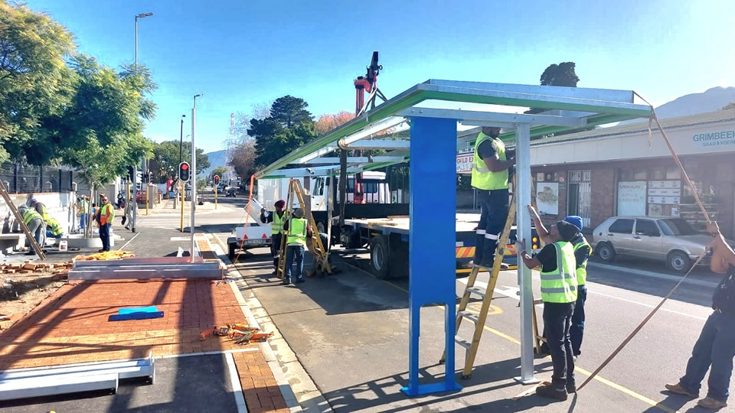
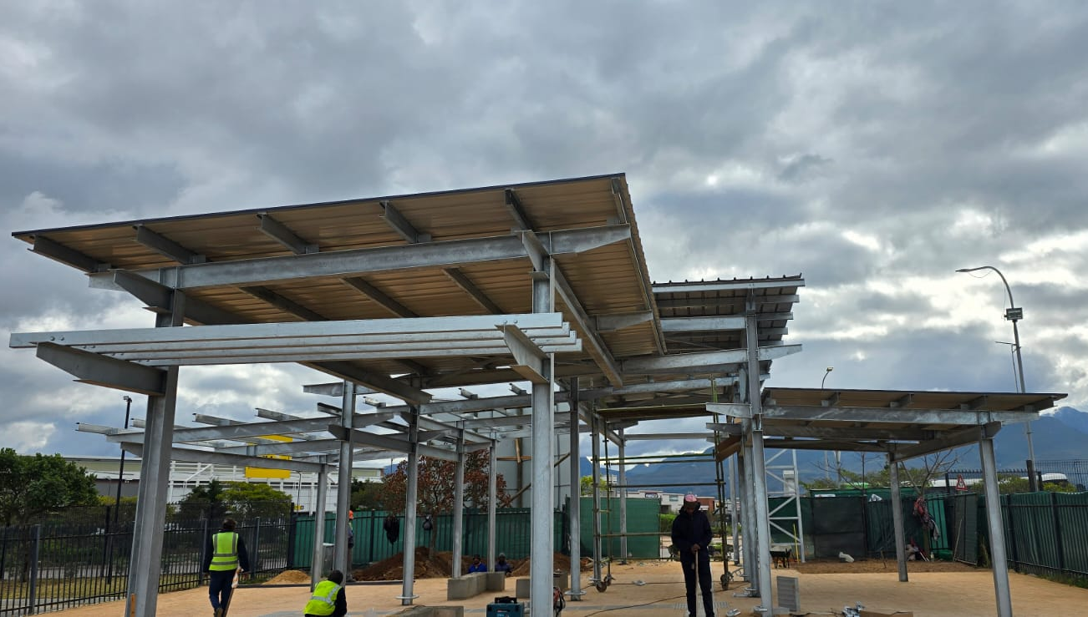
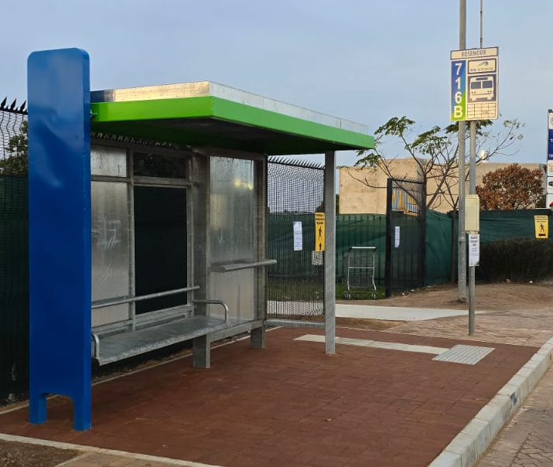
George Integrated Public Transport Network (GIPTN)
GO GEORGE provides a safe, reliable, affordable and accessible quality bus service to the residents of George.
The current focus is completing the roll out of Phase 4A routes and rolling out Phases 5 and 6. This requires focussed efforts to improve infrastructure facilities to support the expanded service.
The GIPTN Infrastructure Programme focuses on making gradual improvements based on the GO GEORGE “infrastructure-light” model
Implementing the programme will cost ~R818 million over 3 financial years, and entails:
  Road rehabilitation: upgrading existing road facilities to support the bus service
  Bus stops & shelters: focus on the improvements to bus stops and shelters, primarily to prepare for Phases 5 & 6
  Transfer locations: entails improvement of key transfer facilities based on the observed usage from passengers
  Sidewalk improvements: particularly focused on ensuring alignment with Universal Accessibility requirements
Provincial Government is undertaking efforts to support the Municipality with a BFI application to support key infrastructure projects for the network in the medium to long term.
Infrastructure Programme Costs | FY 1 (R’000) | FY 2 (R’000) | FY 3 (R’000)
Road rehabilitation | 204 775 | 236 295 | 284 225
Bus stops & shelters | 2 531 | 7 000 | 6 500
Transfer locations | 9 275 | 27 930 | 26 760
Sidewalk improvements | 825 | 4 865 | 6 095
Total | 217 407 | 276 090 | 324 580

Slide 15
GIPTN| Social & technology infrastructure
Panoptic Principle 1 (PP1): Infrastructure Innovation that Drives Equitable Economic, Social, and Ecological Development
Sub-principle | Relevant prescripts | Assessment question | Project response
PP1.1 Infrastructure Design and Material Innovation Integrate prescribed planning frameworks to promote innovation in infrastructure design, and infrastructure material use aligned to national and local development goals. | NT, MTEF, NDP, NIP, NSDF, NLTF, WCSDF 2035, MSDF, PLTF, PSP 2025-2030, G4J, WCIF, WCEIIF, CC response strategy, Green BCSA, SABS, BSA, NDC, CCA 2024, JTF, WCCCRS. | Does the project offer clear evidence of compliance to design innovations pertaining to key planning prescripts and construction material use across the 3 spheres of government? | Design innovation: BRT-lite: Innovative form of BRT that does not require high-cost infrastructure, such as dedicated lanes and median stations. Universally accessible MBT is the first of its kind. Material innovation: Investigation of vandalism-proof material to prevent recurring damage from misuse of bus stops and shelters. Implementation innovation: Incremental and collaborative approach between WCMD and George municipality to roll out the GIPTN in phases.
PP1.2 ICT Innovation Promote innovation in ICT to enhance ease of doing business and government processes, driving economic and governance efficiencies. | NDP, SITA, G4J, WCIF, PSP 2025-2030, PLTF. | Does the project offer clear evidence of compliance to ICT innovations and/or efficiencies like ease-of-doing-business and/or ease-of-doing-government? | Automated Fare Collection system (including provision for new Account-Based Ticketing) promotes ease-of-doing-business by making it easy for passengers to use the GIPTN service. This system will be extended to include the MBTs participating in the co-existence programme. The Public Transport Management System and on-board telematics devices, which will also be extended to include the MBTs participating in the co-existence programme, enable close monitoring of services. This improves the ease-of-doing-government, as compliance with standards and contractual agreements can easily be monitored and reported against.

Slide 16
GIPTN| Social & technology infrastructure
Panoptic Principle 2 (PP2): Innovative infrastructure value chains / ecosystems contribute to building resilient, sustainable, and regenerative systems
Sub-principle | Relevant prescripts | Assessment question | Project response
PP2.1 Resilient Infra. Design and Risk Mitigation Align infrastructure design with resilience principles to address climate change, sustainability, and regenerative practices. It must also address water, energy, and disaster management through proactive risk mitigation strategies and policies. | WCIF, PLTF, NDC, CCA 2024, JTF, WCCCRS, WCEIIF, Green BCSA. | Does the project offer clear evidence of innovations that foster resilience and regenerative aspects of the infrastructure value chain; and are there risk mitigation strategies in place? | Public transport has lower carbon emissions per person than private vehicles because they carry many more people in one vehicle. Providing public transport services, such as GIPTN, supports reduced private vehicle use, which helps to address climate change by reducing carbon emissions.
PP2.2 Infra. Planning for Systemic Alignment Integrated and collaborative planning ensures alignment across spatial, economic, and environmental systems, serving as the foundation for sustainable infrastructure value chains and ecosystems. | NT, MTEF, NDP, NIP, NSDF, NLTF, WCSDF 2035, MSDF, PTLF, PSP 2025-2030, G4J, WCIF, IUDF, IDWRP, EPWP, GPS (DEA&DP 2024). | Does the project offer clear evidence of alignment, integration and collaboration across the WC infrastructure ecosystem? | Integrated and collaborative planning between WCMD and George Municipality, who are jointly responsible for implementing and managing the GIPTN. Improved public transport supports more compact, sustainable development patterns by reducing the need for private vehicles.
PP2.3 Localised Resource Utilisation Reduce socio-ecological costs by sourcing inputs locally and minimising resource transportation needs (this includes consideration of Biodiversity Offsets). | NDC, CCA 2024, JTF, Green BCSA, King IV, WCIF, WCCCRS, WCEIIF. | Does the project offer clear evidence of innovations that foster resilience, sustainable and regenerative aspects of the infrastructure value chain at a local level? | GIPTN supports local resource utilisation by incorporating the local MBT industry into the operation of GIPTN services. The co-existence programme will also be comprised of existing, local MBT operators.

Slide 17
GIPTN| Social & technology infrastructure
Principle 3: Sustainable stakeholder value is created by infrastructure and services that build trust, leverage spatial justice, and the six capitals (incl. value for money as defined by the IDA).
Sub-principle | Relevant prescripts | Assessment question | Project response
PP3.1 Geolocation relative to Spatial Zones: Align infrastructure development to counter spatial inaccessibility via equitable access, capacity building and knowledge management of spatial justice. | SDG's, NDP, NIP, SPLUMA, NSDF, WCSDF 2030, PSP 2025-2030, MSDF, WCIF, PLTF, GPS, State of Development Planning Report and Spatial Performance Report (DEA&DP 2024), RPG-TWG | Does the project offer clear evidence of sustainable stakeholder value fostering trust in context of spatial justice and improved access to infrastructure? | GIPTN services connect low-income areas with areas of opportunity, thereby leveraging spatial justice to benefit the community and the economy.
PP3.2 Public Value and Spatial Justice Innovations: Deliver equitable public value while addressing spatial inequities through innovative projects, fostering inclusive planning & development, with a focus on WYPD. | NSDF, WCSDF 2030, MSDF, WCIF (MOIP), PLTF, GPS, State of Development Planning Report and Spatial Performance Report (DEA&DP 2024) | Does the project offer clear evidence of innovations to counter spatial inequalities, to promote inclusive planning and development? | Improved accessibility for lower income communities. Improving the quality of PT reduces the need for private vehicles and promotes a shift away from the sprawled, car-oriented development patterns that entrench spatial inequality. Shift towards much more equitable and sustainable transit-oriented developments.
PP3.3 Partnerships and Localisation Compliance: Effective partnerships that demonstrates implementation innovation regarding Risk-Reward sharing; And the use of localised value chains to deliver socio-economic benefits, trust, and stakeholder equity. | NT, MTEF, NDP, NIP, NLTF, PLTF, NSDF, PSDF, MSDF, PSP 2025-2030, G4J, WCIF, BSA, SABS, G4J. | Does the project offer clear evidence of desired Partnership models favouring equitable Localised value chain development and risk-sharing? | WCMD partners with George Municipality and the local MBT industry to implement and manage the GIPTN. The GIPTN promotes empowerment of the local MBT industry through formalising and training them to become a formal operating company. Formal employment opportunities for local communities are created throughout the value chain of the GIPTN, including bus driving, facilities management, maintenance, marketing and more. Risks are shared between WCMD and George Municipality through an Intergovernmental Agreement and Financial Agreement, which outline the responsibilities of each party and outline cost-sharing arrangements.

Slide 18
GIPTN| Social & technology infrastructure
Principle 4: Infrastructure design, commission, delivery and management is best supported and enabled by transversal planning and governance.
Sub-principle | Relevant prescripts | Assessment question | Project response
PP4.1 Funding and Budget Compliance: Compliance with provincial, national and international financial and budgetary frameworks to ensure funding sustainability and fiscal discipline. | NT, MTEF, NDP, NIP, PT, G4J, WCIF. | Does the project offer offer funding and financing governance frameworks (financial model, etc.) and PFMA and MFMA budgetary compliances; and taking into consideration the IFRS when necessary? | The GIPTN design, implementation and operations are fully compliant with relevant legislation, including the PFMA and the MFMA. This includes its financial, institutional and legal arrangements. The GIPTN has an established track record of compliance with municipal, provincial and national reporting requirements. The GIPTN submits and updated Business Plan, Financial Plan and detailed funding application to National Department of Transport annually to qualify for PTNG funding. In addition, the GIPTN provides extensive financial reports monthly, quarterly and annually in accordance with the Intergovernmental Agreement and Financial Agreement between WCMD and George Municipality, all of which are compliant with PFMA and MFMA requirements.
PP4.2 Socio-economic Compliance: Adherence to socio-economic planning frameworks and policies, aligning infrastructure projects with growth development priorities and policy objectives as part of effective governance and transversal planning (also take into consideration decommissioning and repurposing). | NSDF, WCSDF 2030, MSDF, WCIF, PLTF, MOIP, G4J. | Does the project offer clear evidence of alignment of socio-economic growth and development priorities required by transversal planning prescripts? | Improves access and mobility for all, including low-income communities and people living with disabilities. Supports economy through transport of workers and learners, including partnerships with local businesses to serve as part of a network of top-up vendors. Continuous evaluation of the socio-economic impact through the annual Macro-Transport and Socio-Economic Surveys.

Slide 19
Rural intertown transport solution

Slide 20
Rural Intertown Transport Solution
The Department is investigating a Rural Intertown Transport Solution to provide safe, reliable and affordable transport between towns in rural areas to improve access to economic opportunities and essential services.
A Business Case is under development, to be completed this financial year. Funding is required for implementation.
Total programme costs are as follows:
Infrastructure requirements & costs
 | 2025/26 (R’000) | 2026/27 (R’000) | 2028/29 (R’000)
Planning | 4 000 | -
Implementation | 7 400 | 18 000 | 20 000
Total | 11 400 | 18 000 | 20 000
Where required, stops, shelters and PTIs will be constructed and/or upgraded to support services and ensure universal accessibility
Total estimated infrastructure cost is ~ R2 million over the first 2 financial years - subject to more detailed costing and needs analysis during business case development and data collection
  Planning costs include (Funded and currently underway): Surveys to gauge passenger demand; business plan; industry engagements; establishing agreements
  Implementation costs include:
    Capital costs - vehicle tracking; payment/ ticketing equipment (if not cash); vehicle branding; validation of vehicles; vehicle refurbishment (if required); infrastructure (stops / shelters) and PTI upgrades if required
    Operating costs - running cost (per vehicle); Training for MBT; concessions to passengers, Marketing and customer engagement
  Assumptions:
  Services will target weekly and Saturday travel, with services being offered on selected days per week
  Existing MBT/ PT Fleet to be utilised, adhering to minimum requirements
  Beaufort West would be operationalised in the last quarter of 2025/26 and Theewaterskloof in 2026/27
2025/26 (R’000) | 2026/27 (R’000) | 2028/29 (R’000)
1 000 | 1 000 | -
Includes infrastructure costs

Slide 21
Rural intertown transport solution| Social infrastructure
Panoptic Principle 1 (PP1): Infrastructure Innovation that Drives Equitable Economic, Social, and Ecological Development
Sub-principle | Relevant prescripts | Assessment question | Project response
PP1.1 Infrastructure Design and Material Innovation Integrate prescribed planning frameworks to promote innovation in infrastructure design, and infrastructure material use aligned to national and local development goals. | NT, MTEF, NDP, NIP, NSDF, NLTF, WCSDF 2035, MSDF, PLTF, PSP 2025-2030, G4J, WCIF, WCEIIF, CC response strategy, Green BCSA, SABS, BSA, NDC, CCA 2024, JTF, WCCCRS. | Does the project offer clear evidence of compliance to design innovations pertaining to key planning prescripts and construction material use across the 3 spheres of government? | As a largely operations-based project, the innovation lies in the operating model developed, which includes a new approach to improving rural connectivity in partnership with the MBT industry.
PP1.2 ICT Innovation Promote innovation in ICT to enhance ease of doing business and government processes, driving economic and governance efficiencies. | NDP, SITA, G4J, WCIF, PSP 2025-2030, PLTF. | Does the project offer clear evidence of compliance to ICT innovations and/or efficiencies like ease-of-doing-business and/or ease-of-doing-government? | ICT will be leveraged through the installation of vehicle tracking and monitoring software in MBTs. This will improve the WCMD’s ease-of-doing-government by providing detailed data on adherence to legal routes and road safety standards. Innovative, cashless payment mechanisms will be implemented to improve the ease-of-doing-business for MBT passengers and operators.

Slide 22
Rural intertown transport solution| Social infrastructure
Panoptic Principle 2 (PP2): Innovative infrastructure value chains / ecosystems contribute to building resilient, sustainable, and regenerative systems
Sub-principle | Relevant prescripts | Assessment question | Project response
PP2.1 Resilient Infra. Design and Risk Mitigation Align infrastructure design with resilience principles to address climate change, sustainability, and regenerative practices. It must also address water, energy, and disaster management through proactive risk mitigation strategies and policies. | WCIF, PLTF, NDC, CCA 2024, JTF, WCCCRS, WCEIIF, Green BCSA. | Does the project offer clear evidence of innovations that foster resilience and regenerative aspects of the infrastructure value chain; and are there risk mitigation strategies in place? | Public transport has lower carbon emissions per person than private vehicles because they carry many more people in one vehicle. Providing a public transport service, such as the rural intertown transport solution, supports reduced private vehicle use, which helps to address climate change by reducing carbon emissions.
PP2.2 Infra. Planning for Systemic Alignment Integrated and collaborative planning ensures alignment across spatial, economic, and environmental systems, serving as the foundation for sustainable infrastructure value chains and ecosystems. | NT, MTEF, NDP, NIP, NSDF, NLTF, WCSDF 2035, MSDF, PTLF, PSP 2025-2030, G4J, WCIF, IUDF, IDWRP, EPWP, GPS (DEA&DP 2024). | Does the project offer clear evidence of alignment, integration and collaboration across the WC infrastructure ecosystem? | Integrated and collaborative planning between WCMD, local municipality partners and the MBT industry to implement the rural intertown transport solution. Improved public transport supports more compact, sustainable development patterns by reducing the need for private vehicles.
PP2.3 Localised Resource Utilisation Reduce socio-ecological costs by sourcing inputs locally and minimising resource transportation needs (this includes consideration of Biodiversity Offsets). | NDC, CCA 2024, JTF, Green BCSA, King IV, WCIF, WCCCRS, WCEIIF. | Does the project offer clear evidence of innovations that foster resilience, sustainable and regenerative aspects of the infrastructure value chain at a local level? | The rural intertown transport service will be operated by the existing, local MBT industry, ensuring that labour and resources (i.e. vehicles) are sourced locally.

Slide 23
Rural intertown transport solution| Social infrastructure
Principle 3: Sustainable stakeholder value is created by infrastructure and services that build trust, leverage spatial justice, and the six capitals (incl. value for money as defined by the IDA).
Sub-principle | Relevant prescripts | Assessment question | Project response
PP3.1 Geolocation relative to Spatial Zones: Align infrastructure development to counter spatial inaccessibility via equitable access, capacity building and knowledge management of spatial justice. | SDG's, NDP, NIP, SPLUMA, NSDF, WCSDF 2030, PSP 2025-2030, MSDF, WCIF, PLTF, GPS, State of Development Planning Report and Spatial Performance Report (DEA&DP 2024), RPG-TWG | Does the project offer clear evidence of sustainable stakeholder value fostering trust in context of spatial justice and improved access to infrastructure? | The project will counter spatial inaccessibility by improving connectivity between towns and increasing access to opportunities. This supports spatial justice. Sustainable stakeholder value and trust will be created through collaboration with the local MBT industry, who will be involved in planning the project and will receive training to build their capacity.
PP3.2 Public Value and Spatial Justice Innovations: Deliver equitable public value while addressing spatial inequities through innovative projects, fostering inclusive planning & development, with a focus on WYPD. | NSDF, WCSDF 2030, MSDF, WCIF (MOIP), PLTF, GPS, State of Development Planning Report and Spatial Performance Report (DEA&DP 2024) | Does the project offer clear evidence of innovations to counter spatial inequalities, to promote inclusive planning and development? | The project will counter spatial inequalities by improving access to opportunities. This supports inclusive planning and development, as it enables rural communities to participate more actively in the economy, education, and social services. This enhanced accessibility bridges the gap between rural areas and fosters inclusivity, reducing regional disparities.
PP3.3 Partnerships and Localisation Compliance: Effective partnerships that demonstrates implementation innovation regarding Risk-Reward sharing; And the use of localised value chains to deliver socio-economic benefits, trust, and stakeholder equity. | NT, MTEF, NDP, NIP, NLTF, PLTF, NSDF, PSDF, MSDF, PSP 2025-2030, G4J, WCIF, BSA, SABS, G4J. | Does the project offer clear evidence of desired Partnership models favouring equitable Localised value chain development and risk-sharing? | WCMD will partner with local municipalities and the MBT industry to plan and implement this project. This will ensure that value chains are localised, as the rural intertown transport service will be operated by the existing, local MBT industry, who will also receive training and skills development to enhance socio-economic benefits of the project. The costs for the project will be shared between the WCMD and the local partner municipalities to help foster risk-sharing from a financial perspective.

Slide 24
Rural intertown transport solution| Social infrastructure
Principle 4: Infrastructure design, commission, delivery and management is best supported and enabled by transversal planning and governance.
Sub-principle | Relevant prescripts | Assessment question | Project response
PP4.1 Funding and Budget Compliance: Compliance with provincial, national and international financial and budgetary frameworks to ensure funding sustainability and fiscal discipline. | NT, MTEF, NDP, NIP, PT, G4J, WCIF. | Does the project offer offer funding and financing governance frameworks (financial model, etc.) and PFMA and MFMA budgetary compliances; and taking into consideration the IFRS when necessary? | Projects are designed to be fully compliant with relevant legislation, including the PFMA and, where relevant, the MFMA. Projects have been developed to-date in compliance with this legislation. For projects reaching implementation and operation, requirements of the PFMA and MFMA have been incorporated into the project design including financial, institutional and legal arrangements underpinning the projects.
PP4.2 Socio-economic Compliance: Adherence to socio-economic planning frameworks and policies, aligning infrastructure projects with growth development priorities and policy objectives as part of effective governance and transversal planning (also take into consideration decommissioning and repurposing). | NSDF, WCSDF 2030, MSDF, WCIF, PLTF, MOIP, G4J. | Does the project offer clear evidence of alignment of socio-economic growth and development priorities required by transversal planning prescripts? | Supports provincial economy: MBTs play a vital role in connecting majority of public transport users to their jobs and essential services. Empowerment: Assists with empowerment and formalisation of the MBT industry

Slide 25
NMT Demonstration Town

Slide 26
NMT Demonstration Town
The NMT Demonstration Town aims to test NMT improvement measures and create a model for a safe, high-quality, comprehensive NMT network that can be replicated across the province.
A Business Case is under development (to be completed this financial year), and efforts are underway to secure funding for implementation.
Total programme costs are as follows:
Infrastructure requirements & costs
 | 2025/26 (R’000) | 2026/27 (R’000) | 2028/29 (R’000)
Establishment costs | 3 500 | - | -
Implementation costs | 51 750 | 54 855 | 58 146
Other programme costs | 12 000 | 12 720 | 13 483
Total | 67 250 | 67 575 | 71 629
Infrastructure elements of the programme include:
  NMT and PT infrastructure designs and upgrades
  Implementing traffic calming measures (e.g., raised intersections) and NMT priority measures at intersections
  Improving signage, wayfinding and lighting
  Ensuring infrastructure is universally accessible
The total infrastructure costs are ~ R165 million over the first 3 financial years - subject to refinements as project business case is being finalised
  Establishment costs include: Preparatory work, such as updating designs and the NMT Master Plan (as required), finalising the implementation plan and developing a detailed M&E framework
  Implementation costs include: Materials and labour for infrastructure implementation; procurement and construction supervision fees; additional design (as required) and programme management
  Other programme costs include: Awareness and behaviour change campaigns; scaled-up bicycle distribution
Includes infrastructure costs

Slide 27
NMT Demonstration Town| Social infrastructure
Panoptic Principle 1 (PP1): Infrastructure Innovation that Drives Equitable Economic, Social, and Ecological Development
Sub-principle | Relevant prescripts | Assessment question | Project response
PP1.1 Infrastructure Design and Material Innovation Integrate prescribed planning frameworks to promote innovation in infrastructure design, and infrastructure material use aligned to national and local development goals. | NT, MTEF, NDP, NIP, NSDF, NLTF, WCSDF 2035, MSDF, PLTF, PSP 2025-2030, G4J, WCIF, WCEIIF, CC response strategy, Green BCSA, SABS, BSA, NDC, CCA 2024, JTF, WCCCRS. | Does the project offer clear evidence of compliance to design innovations pertaining to key planning prescripts and construction material use across the 3 spheres of government? | Design innovation: Network and complete streets approach: Supports comprehensive network, incl. walking, cycling, and universal design principles Multi-modal approach: Creates NMT-friendly PTIs/ranks and improves NMT access to PTIs/ranks First-of-its-kind: First NMT-focused pilot in South Africa to identify effective improvement measures that can be replicated elsewhere Material innovation: Pavement solutions: Will investigate the use of materials that enhance durability and sustainability, and improve safety (e.g., high-contrast sidewalks) Implementation innovation: Scaled-up Bicycle Distribution: To promote NMT use Partnerships: With local municipality, NGOs/NPOs, DOI, police, and business to enhance impact Data-driven: User feedback, road crash statistics and other data will be used to determine effectiveness of tested solutions
PP1.2 ICT Innovation Promote innovation in ICT to enhance ease of doing business and government processes, driving economic and governance efficiencies. | NDP, SITA, G4J, WCIF, PSP 2025-2030, PLTF. | Does the project offer clear evidence of compliance to ICT innovations and/or efficiencies like ease-of-doing-business and/or ease-of-doing-government? | ICT will be leveraged for improved wayfinding, user feedback, NMT user counts, behaviour change campaigns on social media and reporting safety incidents. ICT feedback channels enable improved governance.

Slide 28
NMT Demonstration Town| Social infrastructure
Panoptic Principle 2 (PP2): Innovative infrastructure value chains / ecosystems contribute to building resilient, sustainable, and regenerative systems
Sub-principle | Relevant prescripts | Assessment question | Project response
PP2.1 Resilient Infra. Design and Risk Mitigation Align infrastructure design with resilience principles to address climate change, sustainability, and regenerative practices. It must also address water, energy, and disaster management through proactive risk mitigation strategies and policies. | WCIF, PLTF, NDC, CCA 2024, JTF, WCCCRS, WCEIIF, Green BCSA. | Does the project offer clear evidence of innovations that foster resilience and regenerative aspects of the infrastructure value chain; and are there risk mitigation strategies in place? | NMT infrastructure itself helps to address climate change, as it enables the use of this zero-emissions mode of transport. Improved NMT infrastructure enables a shift away from motorised transport, which further supports climate change mitigation strategies. Use of suitable pavement materials, elevated pathways and structures for shade, where applicable, to promote climate-resilience and mitigate the impact of extreme weather.
PP2.2 Infra. Planning for Systemic Alignment Integrated and collaborative planning ensures alignment across spatial, economic, and environmental systems, serving as the foundation for sustainable infrastructure value chains and ecosystems. | NT, MTEF, NDP, NIP, NSDF, NLTF, WCSDF 2035, MSDF, PTLF, PSP 2025-2030, G4J, WCIF, IUDF, IDWRP, EPWP, GPS (DEA&DP 2024). | Does the project offer clear evidence of alignment, integration and collaboration across the WC infrastructure ecosystem? | Integrated and collaborative planning: Collaboration between WCMD and the local municipality partner to implement NMT improvements. Opportunities for cross-sector collaboration with other departments, including WCED to distribute bicycles to learners and DOI to implement infrastructure upgrades. Integrating infrastructure: Greater integration between NMT and public transport infrastructure. Sustainable infrastructure ecosystems: Promotes increased use of NMT and public transport (sustainable transport modes).
PP2.3 Localised Resource Utilisation Reduce socio-ecological costs by sourcing inputs locally and minimising resource transportation needs (this includes consideration of Biodiversity Offsets). | NDC, CCA 2024, JTF, Green BCSA, King IV, WCIF, WCCCRS, WCEIIF. | Does the project offer clear evidence of innovations that foster resilience, sustainable and regenerative aspects of the infrastructure value chain at a local level? | Materials and labour to be sourced locally, minimising resource transportation needs.

Slide 29
NMT Demonstration Town| Social infrastructure
Principle 3: Sustainable stakeholder value is created by infrastructure and services that build trust, leverage spatial justice, and the six capitals (incl. value for money as defined by the IDA).
Sub-principle | Relevant prescripts | Assessment question | Project response
PP3.1 Geolocation relative to Spatial Zones: Align infrastructure development to counter spatial inaccessibility via equitable access, capacity building and knowledge management of spatial justice. | SDG's, NDP, NIP, SPLUMA, NSDF, WCSDF 2030, PSP 2025-2030, MSDF, WCIF, PLTF, GPS, State of Development Planning Report and Spatial Performance Report (DEA&DP 2024), RPG-TWG | Does the project offer clear evidence of sustainable stakeholder value fostering trust in context of spatial justice and improved access to infrastructure? | A comprehensive NMT network would counter spatial inaccessibility by linking residential areas with opportunities, supporting spatial justice. NMT infrastructure provides equitable access in that it is the most affordable mode of transport, requiring no user cost – except bicycles, the cost of which is covered by the Bicycle Distribution Programme. Capacity building: Of local partner municipality to deliver improved NMT infrastructure, and capacity building of value chain stakeholders in bicycle manufacturing / small bicycle repair companies.
PP3.2 Public Value and Spatial Justice Innovations: Deliver equitable public value while addressing spatial inequities through innovative projects, fostering inclusive planning & development, with a focus on WYPD. | NSDF, WCSDF 2030, MSDF, WCIF (MOIP), PLTF, GPS, State of Development Planning Report and Spatial Performance Report (DEA&DP 2024) | Does the project offer clear evidence of innovations to counter spatial inequalities, to promote inclusive planning and development? | Improved NMT infrastructure and safety measures will reduce pedestrian fatalities, which currently account for ~50% of road fatalities. This will create a built environment that is inclusive of and safer for pedestrians. Greater access to opportunities, particularly for low-income households: NMT provides a low-cost and low-carbon alternative; bicycle distribution supports improved mobility and job creation.
PP3.3 Partnerships and Localisation Compliance: Effective partnerships that demonstrates implementation innovation regarding Risk-Reward sharing; And the use of localised value chains to deliver socio-economic benefits, trust, and stakeholder equity. | NT, MTEF, NDP, NIP, NLTF, PLTF, NSDF, PSDF, MSDF, PSP 2025-2030, G4J, WCIF, BSA, SABS, G4J. | Does the project offer clear evidence of desired Partnership models favouring equitable Localised value chain development and risk-sharing? | Partnership is a key component of this initiative. WCMD will partner with: Local partner municipality to plan and implement NMT improvements DOI to implement infrastructure upgrades Police for increased visibility and enforcement Private sector to support / scale initiatives As noted previously, materials and labour will be sourced locally to boost the local value chain. Risk-sharing models will be explored whereby local businesses contribute to bicycle distribution and other NMT improvement measures, since these interventions will help to enable greater access to their services.

Slide 30
NMT Demonstration Town| Social infrastructure
Principle 4: Infrastructure design, commission, delivery and management is best supported and enabled by transversal planning and governance.
Sub-principle | Relevant prescripts | Assessment question | Project response
PP4.1 Funding and Budget Compliance: Compliance with provincial, national and international financial and budgetary frameworks to ensure funding sustainability and fiscal discipline. | NT, MTEF, NDP, NIP, PT, G4J, WCIF. | Does the project offer offer funding and financing governance frameworks (financial model, etc.) and PFMA and MFMA budgetary compliances; and taking into consideration the IFRS when necessary? | Projects are designed to be fully compliant with relevant legislation, including the PFMA and, where relevant, the MFMA. Projects have been developed to-date in compliance with this legislation. For projects reaching implementation and operation, requirements of the PFMA and MFMA have been incorporated into the project design including financial, institutional and legal arrangements underpinning the projects. To ensure funding sustainability and fiscal discipline, the WCMD plans to approach business and other possible sponsors to explore contribution to bicycle distribution programme.
PP4.2 Socio-economic Compliance: Adherence to socio-economic planning frameworks and policies, aligning infrastructure projects with growth development priorities and policy objectives as part of effective governance and transversal planning (also take into consideration decommissioning and repurposing). | NSDF, WCSDF 2030, MSDF, WCIF, PLTF, MOIP, G4J. | Does the project offer clear evidence of alignment of socio-economic growth and development priorities required by transversal planning prescripts? | This project demonstrates alignment with transversal planning prescripts, such as the G4J focus areas of: Energy Resilience and Transition to Net Zero Carbon: Supports zero-emissions transport. Infrastructure and Connected Economy: Supports job creation through construction and bicycle distribution programme. Improved Access to Economic Opportunities and Employability: Project improves access and mobility for all, including low-income communities and people living with disabilities.

Slide 31
Park and Ride

Slide 32
Park and Ride
The Department completed a pre-feasibility study of Park and Rides (P&R) to support long-term decongestion, focusing on pilot options in Cape Town and Stellenbosch.
A further investigation into the ideal business model and operational planning is currently underway for the Stellenbosch pilot, in partnership with Stellenbosch Municipality. Funding is required for implementation.
Cape Town P&R costs and infrastructure requirements
Stellenbosch P&R costs and infrastructure requirements
  Estimated cost is ~ R25m over 3 years to set up and operate two pilot park and ride sites as part of a pilot. Costs entail:
  Infrastructure costs: upgrades/ construction on two facilities (Heathfield and Fish Hoek) to better support P&R
  Other establishment costs: technology setup
  Operating costs: site management and maintenance; security; CCVT; technology management and marketing
  Estimated cost of ~R170m over 3 years, to roll out one new route per year with parking facilities. Costs entail:
  Infrastructure costs: site upgrades, e.g., paving upgrades, geotechnical work, fencing etc.
  Other establishment costs: construction and technology setup
  Operating costs: vehicle lease and operating costs; site management and technology
 | FY 1 (R’000) | FY 2 (R’000) | FY 3 (R’000)
Infrastructure costs | 10 130 | - | -
Other establishment costs | 520 | 80 | 80
Operating costs | 4 310 | 4 570 | 4 840
Total | 14 960 | 4 650 | 4 920
 | FY 1 (R’000) | FY 2 (R’000) | FY 3 (R’000)
Infrastructure costs | 19 500 | - | -
Other establishment costs | 32 680 | 24 820 | 24 860
Operating costs | 20 270 | 21 320 | 22 460
Total | 72 450 | 46 140 | 47 320
Infrastructure costs

Slide 33
Park and Ride| Social infrastructure
Panoptic Principle 1 (PP1): Infrastructure Innovation that Drives Equitable Economic, Social, and Ecological Development
Sub-principle | Relevant prescripts | Assessment question | Project response
PP1.1 Infrastructure Design and Material Innovation Integrate prescribed planning frameworks to promote innovation in infrastructure design, and infrastructure material use aligned to national and local development goals. | NT, MTEF, NDP, NIP, NSDF, NLTF, WCSDF 2035, MSDF, PLTF, PSP 2025-2030, G4J, WCIF, WCEIIF, CC response strategy, Green BCSA, SABS, BSA, NDC, CCA 2024, JTF, WCCCRS. | Does the project offer clear evidence of compliance to design innovations pertaining to key planning prescripts and construction material use across the 3 spheres of government? | This will be the first P&R initiative in Stellenbosch. Public transport options are extremely lacking in Stellenbosch; P&Rs will introduce a new travel option to this region. WCMD would work together with CoCT, Stellenbosch and PRASA to implement P&R upgrades / expansions – a first in implementation. All infrastructure will comply with WCIF and SABS standards.
PP1.2 ICT Innovation Promote innovation in ICT to enhance ease of doing business and government processes, driving economic and governance efficiencies. | NDP, SITA, G4J, WCIF, PSP 2025-2030, PLTF. | Does the project offer clear evidence of compliance to ICT innovations and/or efficiencies like ease-of-doing-business and/or ease-of-doing-government? | Both Cape Town and Stellenbosch services will offer the ability for users to check parking availability online and remotely. In Stellenbosch, users will be able to pre-book seats on the shuttle and buy tickets online.

Slide 34
Park and Ride| Social infrastructure
Panoptic Principle 2 (PP2): Innovative infrastructure value chains / ecosystems contribute to building resilient, sustainable, and regenerative systems
Sub-principle | Relevant prescripts | Assessment question | Project response
PP2.1 Resilient Infra. Design and Risk Mitigation Align infrastructure design with resilience principles to address climate change, sustainability, and regenerative practices. It must also address water, energy, and disaster management through proactive risk mitigation strategies and policies. | WCIF, PLTF, NDC, CCA 2024, JTF, WCCCRS, WCEIIF, Green BCSA. | Does the project offer clear evidence of innovations that foster resilience and regenerative aspects of the infrastructure value chain; and are there risk mitigation strategies in place? | PT has lower emissions per person than private vehicles because they carry many more people in one vehicle. Improved PT also supports reduced private vehicle use, further lowering emissions and congestion. Lower levels of congestion mean less pressure on the road network, thus lowering road maintenance requirements Should rollout continue, integration of facilities for electric vehicle charging will be included at PnR parking lots, and the Stellenbosch shuttle fleet is proposed as an electric fleet.
PP2.2 Infra. Planning for Systemic Alignment Integrated and collaborative planning ensures alignment across spatial, economic, and environmental systems, serving as the foundation for sustainable infrastructure value chains and ecosystems. | NT, MTEF, NDP, NIP, NSDF, NLTF, WCSDF 2035, MSDF, PTLF, PSP 2025-2030, G4J, WCIF, IUDF, IDWRP, EPWP, GPS (DEA&DP 2024). | Does the project offer clear evidence of alignment, integration and collaboration across the WC infrastructure ecosystem? | Improved PT supports improved connections to employment and services, which supports spatial integration. It also supports more compact, sustainable development patterns by reducing the need for private vehicles. Introducing PnR is part of the work proposed in both COCT and the Stellenbosch municipality’s CITPs.
PP2.3 Localised Resource Utilisation Reduce socio-ecological costs by sourcing inputs locally and minimising resource transportation needs (this includes consideration of Biodiversity Offsets). | NDC, CCA 2024, JTF, Green BCSA, King IV, WCIF, WCCCRS, WCEIIF. | Does the project offer clear evidence of innovations that foster resilience, sustainable and regenerative aspects of the infrastructure value chain at a local level? | Materials and labour to be sourced locally, minimising resource transportation needs.

Slide 35
Park and Ride| Social infrastructure
Principle 3: Sustainable stakeholder value is created by infrastructure and services that build trust, leverage spatial justice, and the six capitals (incl. value for money as defined by the IDA).
Sub-principle | Relevant prescripts | Assessment question | Project response
PP3.1 Geolocation relative to Spatial Zones: Align infrastructure development to counter spatial inaccessibility via equitable access, capacity building and knowledge management of spatial justice. | SDG's, NDP, NIP, SPLUMA, NSDF, WCSDF 2030, PSP 2025-2030, MSDF, WCIF, PLTF, GPS, State of Development Planning Report and Spatial Performance Report (DEA&DP 2024), RPG-TWG | Does the project offer clear evidence of sustainable stakeholder value fostering trust in context of spatial justice and improved access to infrastructure? | In Stellenbosch a new public transport service is proposed, connecting commuters between nodes in line with the Stellenbosch municipality’s CITP and seeking to decongest the highly congested CBD. In Cape Town, improved P&R facilities will increase access to rail services and infrastructure, and support greater use of passenger rail which should be restored as the backbone of public transport in the province
PP3.2 Public Value and Spatial Justice Innovations: Deliver equitable public value while addressing spatial inequities through innovative projects, fostering inclusive planning & development, with a focus on WYPD. | NSDF, WCSDF 2030, MSDF, WCIF (MOIP), PLTF, GPS, State of Development Planning Report and Spatial Performance Report (DEA&DP 2024) | Does the project offer clear evidence of innovations to counter spatial inequalities, to promote inclusive planning and development? | Park and Rides will aid decongestion, which will save taxpayer money spent on road maintenance. Reduced congestion also makes transport networks more efficient and accessible for all P&Rs reduce car dependency and encourage mixed land-use development around transport hubs – countering spatial inequality Reduced carbon emissions from fewer vehicles will also support preservation of natural capital.
PP3.3 Partnerships and Localisation Compliance: Effective partnerships that demonstrates implementation innovation regarding Risk-Reward sharing; And the use of localised value chains to deliver socio-economic benefits, trust, and stakeholder equity. | NT, MTEF, NDP, NIP, NLTF, PLTF, NSDF, PSDF, MSDF, PSP 2025-2030, G4J, WCIF, BSA, SABS, G4J. | Does the project offer clear evidence of desired Partnership models favouring equitable Localised value chain development and risk-sharing? | Partnerships with CoCT, PRASA, and Stellenbosch Municipality, and integration of the MBT industry where possible, enabling the long-term collaboration needed to restore rail in the Western Cape – a key provincial transport priority – and support the formalisation of the MBT industry. An MOU with PRASA and the MD is in draft as is the MOU between Stellenbosch Municipality and the MD, and IGAs will be concluded for the implementation of the projects.

Slide 36
Park and Ride| Social infrastructure
Principle 4: Infrastructure design, commission, delivery and management is best supported and enabled by transversal planning and governance.
Sub-principle | Relevant prescripts | Assessment question | Project response
PP4.1 Funding and Budget Compliance: Compliance with provincial, national and international financial and budgetary frameworks to ensure funding sustainability and fiscal discipline. | NT, MTEF, NDP, NIP, PT, G4J, WCIF. | Does the project offer offer funding and financing governance frameworks (financial model, etc.) and PFMA and MFMA budgetary compliances; and taking into consideration the IFRS when necessary? | Transversal coordination with PRASA, CoCT and Stellenbosch Municipality will be core to this project to minimise duplication while maximising value for money. Projects are designed to be fully compliant with relevant legislation, including the PFMA and, where relevant, the MFMA. Projects have been developed to-date in compliance with this legislation. For projects reaching implementation and operation, requirements of the PFMA and MFMA have been incorporated into the project design including financial, institutional and legal arrangements underpinning the projects.
PP4.2 Socio-economic Compliance: Adherence to socio-economic planning frameworks and policies, aligning infrastructure projects with growth development priorities and policy objectives as part of effective governance and transversal planning (also take into consideration decommissioning and repurposing). | NSDF, WCSDF 2030, MSDF, WCIF, PLTF, MOIP, G4J. | Does the project offer clear evidence of alignment of socio-economic growth and development priorities required by transversal planning prescripts? | Supports reduced congestion, which enables more productive economies. Supports reduced carbon emissions, which enables a more liveable environment.

Slide 37
Electric minibus taxi (eMBT) pilot

Slide 38
eMBT Pilot
The Department aims to implement an electric MBT pilot to assess the compatibility of EVs with local MBT operations and to inform a future transition at scale within the industry.
A feasibility study has been completed, and the pilot has been designed. The Department is in search of a suitable vehicle to implement the pilot, as no e-MBTs are available in SA (though they do exist internationally).
  The eMBT Pilot would be implemented in 3 phases over 3 years:
    Phase 1 (months 1 to 18)
    2-vehicle pilot across Cape Metro
    Phase 2 (months 19 to 24)
    2-vehicle pilot across Garden Route District Municipality
    Phase 3 (month 25 to 36)
    8-vehicle pilot across all 8 SANTACO WC regions
  The total programme costs are as follows:
Infrastructure requirements & costs
 | FY 1 (R’000) | FY 2 (R’000) | FY 3 (R’000)
Capital costs | 8 791 | 612 | 27 382
Operational costs | 1 978 | 578 | 9 136
Total | 10 769 | 1 190 | 36 518
  To implement the pilot, the following infrastructure elements are required:
    Charging equipment and PTI upgrades (12 PTIs)
The total infrastructure cost for the pilot is ~R8.5 million over the first 3 financial years:
Includes infrastructure costs
  Assumptions:
  Costs estimated for 8 vehicles
  Operational costs include energy, insurance, vehicle maintenance, and security
FY 1 (R’000) | FY 2 (R’000) | FY 3 (R’000)
600 | 300 | 7 600

Slide 39
eMBT pilot| Energy infrastructure
Panoptic Principle 1 (PP1): Infrastructure Innovation that Drives Equitable Economic, Social, and Ecological Development
Sub-principle | Relevant prescripts | Assessment question | Project response
PP1.1 Infrastructure Design and Material Innovation Integrate prescribed planning frameworks to promote innovation in infrastructure design, and infrastructure material use aligned to national and local development goals. | NT, MTEF, NDP, NIP, NSDF, NLTF, WCSDF 2035, MSDF, PLTF, PSP 2025-2030, G4J, WCIF, WCEIIF, CC response strategy, Green BCSA, SABS, BSA, NDC, CCA 2024, JTF, WCCCRS. | Does the project offer clear evidence of compliance to design innovations pertaining to key planning prescripts and construction material use across the 3 spheres of government? | Charging stations: Introducing new electric vehicle charging infrastructure to key public transport interchanges for the Minibus Taxi industry, which will support the piloting of BEVs (battery electric vehicles) for MBT sector. First real-world commercial service eMBT pilot in South Africa.
PP1.2 ICT Innovation Promote innovation in ICT to enhance ease of doing business and government processes, driving economic and governance efficiencies. | NDP, SITA, G4J, WCIF, PSP 2025-2030, PLTF. | Does the project offer clear evidence of compliance to ICT innovations and/or efficiencies like ease-of-doing-business and/or ease-of-doing-government? | Vehicle tracking and monitoring equipment will be installed in the eMBTs, along with the setting up of monitoring systems, to measure performance metrics.

Slide 40
eMBT pilot| Energy infrastructure
Panoptic Principle 2 (PP2): Innovative infrastructure value chains / ecosystems contribute to building resilient, sustainable, and regenerative systems
Sub-principle | Relevant prescripts | Assessment question | Project response
PP2.1 Resilient Infra. Design and Risk Mitigation Align infrastructure design with resilience principles to address climate change, sustainability, and regenerative practices. It must also address water, energy, and disaster management through proactive risk mitigation strategies and policies. | WCIF, PLTF, NDC, CCA 2024, JTF, WCCCRS, WCEIIF, Green BCSA. | Does the project offer clear evidence of innovations that foster resilience and regenerative aspects of the infrastructure value chain; and are there risk mitigation strategies in place? | Replacing ICE vehicles with zero emissions (tailpipe) vehicles will lower carbon emissions, thereby reducing the impact of the MBT industry on climate change.
PP2.2 Infra. Planning for Systemic Alignment Integrated and collaborative planning ensures alignment across spatial, economic, and environmental systems, serving as the foundation for sustainable infrastructure value chains and ecosystems. | NT, MTEF, NDP, NIP, NSDF, NLTF, WCSDF 2035, MSDF, PTLF, PSP 2025-2030, G4J, WCIF, IUDF, IDWRP, EPWP, GPS (DEA&DP 2024). | Does the project offer clear evidence of alignment, integration and collaboration across the WC infrastructure ecosystem? | Supporting transition to clean energy sources. Integrated planning with stakeholders (Eskom, CoCT, private sector and others) to roll out charging network.
PP2.3 Localised Resource Utilisation Reduce socio-ecological costs by sourcing inputs locally and minimising resource transportation needs (this includes consideration of Biodiversity Offsets). | NDC, CCA 2024, JTF, Green BCSA, King IV, WCIF, WCCCRS, WCEIIF. | Does the project offer clear evidence of innovations that foster resilience, sustainable and regenerative aspects of the infrastructure value chain at a local level? | Vehicle charging equipment, solar panels, and battery storage are all assembled in South Africa, and will be sourced locally.

Slide 41
eMBT pilot| Energy infrastructure
Principle 3: Sustainable stakeholder value is created by infrastructure and services that build trust, leverage spatial justice, and the six capitals (incl. value for money as defined by the IDA).
Sub-principle | Relevant prescripts | Assessment question | Project response
PP3.1 Geolocation relative to Spatial Zones: Align infrastructure development to counter spatial inaccessibility via equitable access, capacity building and knowledge management of spatial justice. | SDG's, NDP, NIP, SPLUMA, NSDF, WCSDF 2030, PSP 2025-2030, MSDF, WCIF, PLTF, GPS, State of Development Planning Report and Spatial Performance Report (DEA&DP 2024), RPG-TWG | Does the project offer clear evidence of sustainable stakeholder value fostering trust in context of spatial justice and improved access to infrastructure? | Supports the transition of the MBT industry towards BEV technology. The MBT industry supports 75% of public transport trips across the Western Cape, and as such, serves a critical role in supporting more equitable access to opportunities, especially among captive public transport users who are unable to afford alternative modes.
PP3.2 Public Value and Spatial Justice Innovations: Deliver equitable public value while addressing spatial inequities through innovative projects, fostering inclusive planning & development, with a focus on WYPD. | NSDF, WCSDF 2030, MSDF, WCIF (MOIP), PLTF, GPS, State of Development Planning Report and Spatial Performance Report (DEA&DP 2024) | Does the project offer clear evidence of innovations to counter spatial inequalities, to promote inclusive planning and development? | The MBT industry performs a critical role in supporting access to opportunities, especially among poorer communities who have limited or no alternative transport modes available. A large-scale MBT transition to BEV technology will support job creation and stimulate the local economy, combatting unemployment, poverty and inequality
PP3.3 Partnerships and Localisation Compliance: Effective partnerships that demonstrates implementation innovation regarding Risk-Reward sharing; And the use of localised value chains to deliver socio-economic benefits, trust, and stakeholder equity. | NT, MTEF, NDP, NIP, NLTF, PLTF, NSDF, PSDF, MSDF, PSP 2025-2030, G4J, WCIF, BSA, SABS, G4J. | Does the project offer clear evidence of desired Partnership models favouring equitable Localised value chain development and risk-sharing? | WCMD will partner with the MBT industry to test the eMBT. Supports the transition of MBT fleets to BEVs, which will help stimulate the demand necessary to support local vehicle manufacturers to transition from ICE minibuses to electric minibuses. Locally developed and manufactured vehicle charging equipment will be used, as well as locally produced solar panels (to supplement energy demands).

Slide 42
eMBT pilot| Energy infrastructure
Principle 4: Infrastructure design, commission, delivery and management is best supported and enabled by transversal planning and governance.
Sub-principle | Relevant prescripts | Assessment question | Project response
PP4.1 Funding and Budget Compliance: Compliance with provincial, national and international financial and budgetary frameworks to ensure funding sustainability and fiscal discipline. | NT, MTEF, NDP, NIP, PT, G4J, WCIF. | Does the project offer offer funding and financing governance frameworks (financial model, etc.) and PFMA and MFMA budgetary compliances; and taking into consideration the IFRS when necessary? | This project has been designed to be fully compliant with relevant legislation, including the PFMA. For implementation and operation, requirements of the PFMA have been incorporated into the project design including financial, institutional and legal arrangements underpinning the projects.
PP4.2 Socio-economic Compliance: Adherence to socio-economic planning frameworks and policies, aligning infrastructure projects with growth development priorities and policy objectives as part of effective governance and transversal planning (also take into consideration decommissioning and repurposing). | NSDF, WCSDF 2030, MSDF, WCIF, PLTF, MOIP, G4J. | Does the project offer clear evidence of alignment of socio-economic growth and development priorities required by transversal planning prescripts? | Supports reduced carbon emissions and reduced operating costs, which enables a more liveable environment and in the longer term, more affordable transport due to reduced capital and operating costs.

Slide 43
Freight Rail Revitalisation Framework

Slide 44
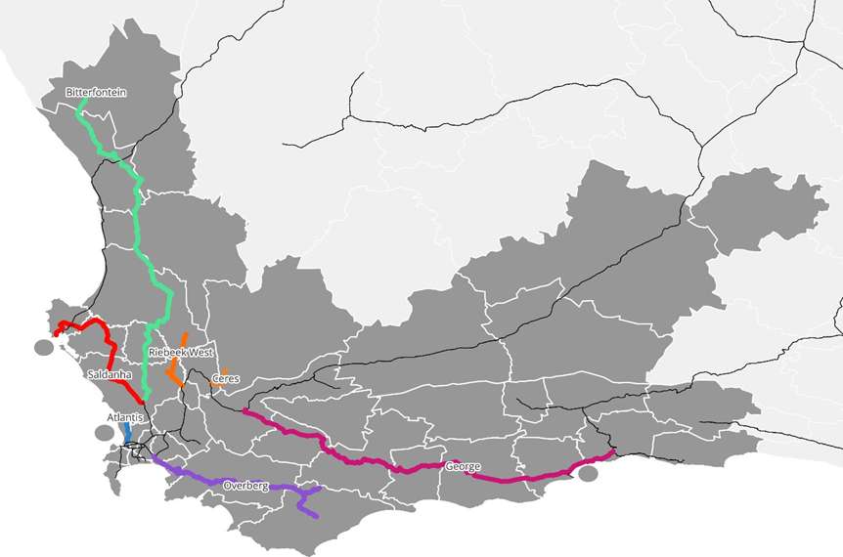

Freight Rail Revitalisation
Overview
Branch lines across the province (e.g., Overberg, Ceres, Saldanha) face severe maintenance backlogs.
Transnet Rail Infrastructure Manager (TRIM) is responsible for upgrades; cost and condition data remain unclear.
WCMD is engaging TRIM to clarify priorities, costs, and possible support models.
Mechanism for investment in rail infrastructure and terminal network by other spheres of government and private sector must still be clarified.
Bitterfontein (380 km)
Saldanha (143 km)
Worcester to George (357 km)
Overberg (211 km)
Riebeek West (60 km)
Ceres (25 km)
Atlantis (24 km)

Slide 45
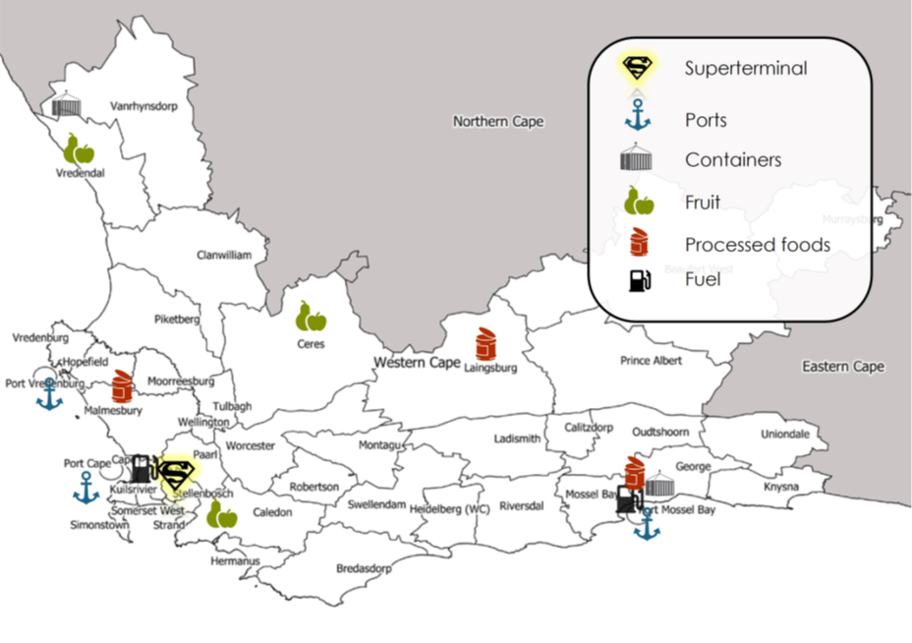
Freight Rail Revitalisation
Infrastructure opportunities
A terminal network is needed to drive integration and support rail viability, i.e., rail supporting infrastructure
Potential for WCMD, DOI (& municipalities) to provide land for facility/terminal development and collaborate with private sector to fund and develop the terminals
  Costs and funding models for terminals require further development
  Investment in rail network e.g., Bredasdorp/Protem and Swellendam)
Potential Western Cape Terminal Network:
Terminal Type | Location | Annual Potential Volume (tonnes)
Super Terminal | Kraaicon | 4 000 000
Container Terminal | George | 170 000
 | Bitterfontein | 170 000
Fruit Terminal | Ceres | 260 000
 | Caledon | 260 000
 | Vredendal | 260 000
Processed Food Terminals | Malmesbury | 400 000
 | George | 240 000
 | Lainsburg | 100 000

Slide 46
Freight Rail Revitalisation | Economic Infrastructure
Panoptic Principle 1 (PP1): Infrastructure Innovation that Drives Equitable Economic, Social, and Ecological Development
Sub-principle | Relevant prescripts | Assessment question | Project response
PP1.1 Infrastructure Design and Material Innovation Integrate prescribed planning frameworks to promote innovation in infrastructure design, and infrastructure material use aligned to national and local development goals. | NT, MTEF, NDP, NIP, NSDF, NLTF, WCSDF 2035, MSDF, PLTF, PSP 2025-2030, G4J, WCIF, WCEIIF, CC response strategy, Green BCSA, SABS, BSA, NDC, CCA 2024, JTF, WCCCRS. | Does the project offer clear evidence of compliance to design innovations pertaining to key planning prescripts and construction material use across the 3 spheres of government? | Rehabilitation work will comply with national standards set by Transnet and DOT, ensuring infrastructure design aligns with mandated frameworks. This includes use of standardised track, signalling, and structural materials specified by Transnet and DOT.
PP1.2 ICT Innovation Promote innovation in ICT to enhance ease of doing business and government processes, driving economic and governance efficiencies. | NDP, SITA, G4J, WCIF, PSP 2025-2030, PLTF. | Does the project offer clear evidence of compliance to ICT innovations and/or efficiencies like ease-of-doing-business and/or ease-of-doing-government? | Innovation is envisaged through private sector participation and PPPs in rail revitalisation and terminal development opportunities. These partnerships are expected to bring in digital solutions for operations (e.g. wagon tracking, terminal automation), investment platforms, and integration with the other systems.

Slide 47
Freight Rail Revitalisation | Economic Infrastructure
Panoptic Principle 2 (PP2): Innovative infrastructure value chains / ecosystems contribute to building resilient, sustainable, and regenerative systems
Sub-principle | Relevant prescripts | Assessment question | Project response
PP2.1 Resilient Infra. Design and Risk Mitigation Align infrastructure design with resilience principles to address climate change, sustainability, and regenerative practices. It must also address water, energy, and disaster management through proactive risk mitigation strategies and policies. | WCIF, PLTF, NDC, CCA 2024, JTF, WCCCRS, WCEIIF, Green BCSA. | Does the project offer clear evidence of innovations that foster resilience and regenerative aspects of the infrastructure value chain; and are there risk mitigation strategies in place? | The project targets long-standing maintenance backlogs and supports catalytic infrastructure like terminals. Rehabilitated lines improve resilience in the rail network, promote competition and reduce risk from over-reliance on road freight, while enabling climate-resilient logistics options. For example, terminals in Worcester or Swellendam can be designed to withstand weather-related disruptions.
PP2.2 Infra. Planning for Systemic Alignment Integrated and collaborative planning ensures alignment across spatial, economic, and environmental systems, serving as the foundation for sustainable infrastructure value chains and ecosystems. | NT, MTEF, NDP, NIP, NSDF, NLTF, WCSDF 2035, MSDF, PTLF, PSP 2025-2030, G4J, WCIF, IUDF, IDWRP, EPWP, GPS (DEA&DP 2024). | Does the project offer clear evidence of alignment, integration and collaboration across the WC infrastructure ecosystem? | Supports Western Cape’s vision of a multimodal system integrated with terminals, ports, and road freight networks. This includes coordination with Belcon inland terminal, Ports of Cape Town, Saldanha and Mossel Bay and alignment with the Western Cape Freight Demand Model (WCFDM), as the corridor-based planning tool.
PP2.3 Localised Resource Utilisation Reduce socio-ecological costs by sourcing inputs locally and minimising resource transportation needs (this includes consideration of Biodiversity Offsets). | NDC, CCA 2024, JTF, Green BCSA, King IV, WCIF, WCCCRS, WCEIIF. | Does the project offer clear evidence of innovations that foster resilience, sustainable and regenerative aspects of the infrastructure value chain at a local level? | Revitalised rail will reduce transport costs and enhance access for local industries in secondary towns. The use of local materials and contractors is envisaged for minor works such as fencing, drainage, and terminal surfacing, in alignment with relevant principles where applicable.

Slide 48
Freight Rail Revitalisation | Economic Infrastructure
Principle 3: Sustainable stakeholder value is created by infrastructure and services that build trust, leverage spatial justice, and the six capitals (incl. value for money as defined by the IDA).
Sub-principle | Relevant prescripts | Assessment question | Project response
PP3.1 Geolocation relative to Spatial Zones: Align infrastructure development to counter spatial inaccessibility via equitable access, capacity building and knowledge management of spatial justice. | SDG's, NDP, NIP, SPLUMA, NSDF, WCSDF 2030, PSP 2025-2030, MSDF, WCIF, PLTF, GPS, State of Development Planning Report and Spatial Performance Report (DEA&DP 2024), RPG-TWG | Does the project offer clear evidence of sustainable stakeholder value fostering trust in context of spatial justice and improved access to infrastructure? | Reconnects marginalised areas to markets, improves local job access, and reduces reliance on distant hubs. Regions like Overberg, Swellendam, Worcester and Elgin benefit from direct connectivity to Cape Town, reducing time and cost for producers while expanding market access.
PP3.2 Public Value and Spatial Justice Innovations: Deliver equitable public value while addressing spatial inequities through innovative projects, fostering inclusive planning & development, with a focus on WYPD. | NSDF, WCSDF 2030, MSDF, WCIF (MOIP), PLTF, GPS, State of Development Planning Report and Spatial Performance Report (DEA&DP 2024) | Does the project offer clear evidence of innovations to counter spatial inequalities, to promote inclusive planning and development? | Promotes inclusive access to logistics and economic opportunities in under-served regions. Freight rail will support more equitable access to export logistics, benefiting small-scale farmers and agri-processors, especially in rural municipalities.
PP3.3 Partnerships and Localisation Compliance: Effective partnerships that demonstrates implementation innovation regarding Risk-Reward sharing; And the use of localised value chains to deliver socio-economic benefits, trust, and stakeholder equity. | NT, MTEF, NDP, NIP, NLTF, PLTF, NSDF, PSDF, MSDF, PSP 2025-2030, G4J, WCIF, BSA, SABS, G4J. | Does the project offer clear evidence of desired Partnership models favouring equitable Localised value chain development and risk-sharing? | PPPs and private sector involvement drive investment, with shared risks and public-sector support. This includes market testing through Requests for Information (RFIs), private terminal investment (e.g. CGA or Agbiz members), and access frameworks that promote lower barriers to entry for local rail operators.

Slide 49
Freight Rail Revitalisation | Economic Infrastructure
Principle 4: Infrastructure design, commission, delivery and management is best supported and enabled by transversal planning and governance.
Sub-principle | Relevant prescripts | Assessment question | Project response
PP4.1 Funding and Budget Compliance: Compliance with provincial, national and international financial and budgetary frameworks to ensure funding sustainability and fiscal discipline. | NT, MTEF, NDP, NIP, PT, G4J, WCIF. | Does the project offer offer funding and financing governance frameworks (financial model, etc.) and PFMA and MFMA budgetary compliances; and taking into consideration the IFRS when necessary? | Eligible for support from instruments like the Budget Facility for Infrastructure (BFI). The project was identified as a potential BFI candidate due to its network significance, climate co-benefits, and long-term cost savings for the economy.
PP4.2 Socio-economic Compliance: Adherence to socio-economic planning frameworks and policies, aligning infrastructure projects with growth development priorities and policy objectives as part of effective governance and transversal planning (also take into consideration decommissioning and repurposing). | NSDF, WCSDF 2030, MSDF, WCIF, PLTF, MOIP, G4J. | Does the project offer clear evidence of alignment of socio-economic growth and development priorities required by transversal planning prescripts? | Though not always commercially profitable, the projects deliver broader socio-economic and environmental returns. The project supports jobs, rural economic development, and modal shift targets. These outcomes align with Growth for Jobs (G4J), PSP 2025–2030, and the PLTF’s goals for regional connectivity and cost competitiveness.

Slide 50
Summary

Slide 51
Summary of Mobility related infrastructure needs
Project | Summary of infrastructure needs | FY 1 (R’000) | FY 2 (R’000) | FY 3 (R’000)
Shayela Smart | Establishment of remote holding areas (RHA) and strategic stop and go (SS&G) facilities in the Metro | 45 250 | 47 965 | -
GIPTN | Road rehabilitation, bus stops and shelters, transfer locations and sidewalk improvements | 217 407 | 276 090 | 324 580
Rural Intertown Transport Solution | Construction of stops, shelters and PTIs where required | 1 000 | 1 000 | -
NMT Demonstration Town | NMT and PT infrastructure upgrades in the selected town | 51 750 | 54 855 | 58 146
Park and Ride | Site upgrades of identified P&R facilities in Cape Town and Stellenbosch | CPT: 10 130 STEL: 19 500 | - | -
eMBT Pilot | Charging equipment and PTI upgrades (12 PTIs) | 600 | 300 | 7 600
Freight Rail Revitalisation | Potential for WCMD, DOI & municipalities to support freight rail viability by providing land for facility/terminal development and collaborating with private sector to fund and develop the terminals | TBD

