Slide 1
Freight Rail Revitalisation Framework

Slide 2
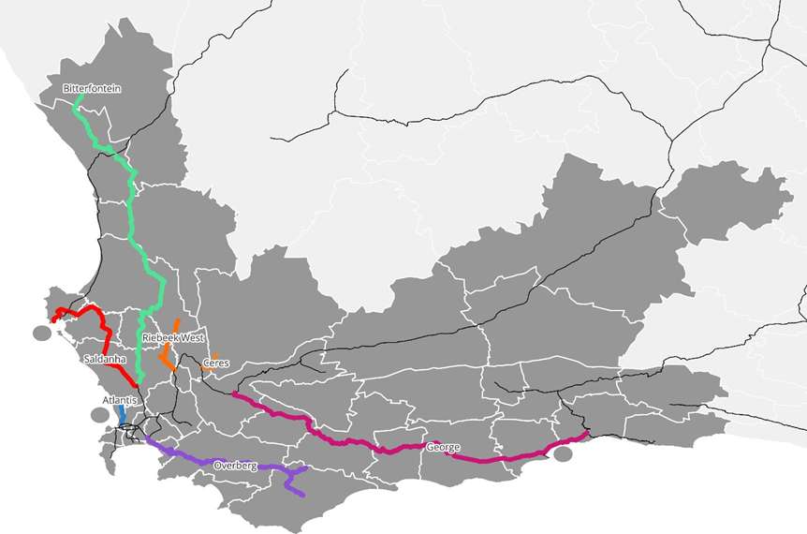

Freight Rail Revitalisation
Overview
Branch lines across the province (e.g., Overberg, Ceres, Saldanha) face severe maintenance backlogs.
Transnet Rail Infrastructure Manager (TRIM) is responsible for upgrades; cost and condition data remain unclear.
WCMD is engaging TRIM to clarify priorities, costs, and possible support models.
Mechanism for investment in rail infrastructure and terminal network by other spheres of government and private sector must still be clarified.
Bitterfontein (380 km)
Saldanha (143 km)
Worcester to George (357 km)
Overberg (211 km)
Riebeek West (60 km)
Ceres (25 km)
Atlantis (24 km)

Slide 3
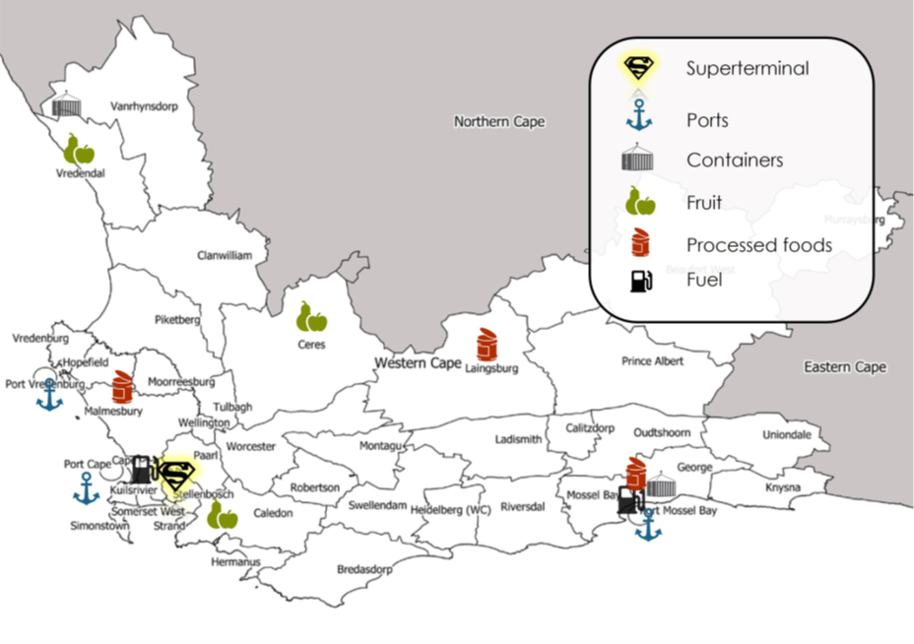
Freight Rail Revitalisation
Infrastructure opportunities
A terminal network is needed to drive integration and support rail viability, i.e., rail supporting infrastructure
Potential for WCMD, DOI (& municipalities) to provide land for facility/terminal development and collaborate with private sector to fund and develop the terminals
  Costs and funding models for terminals require further development
  Investment in rail network e.g., Bredasdorp/Protem and Swellendam)
Potential Western Cape Terminal Network:
Terminal Type | Location | Annual Potential Volume (tonnes)
Super Terminal | Kraaicon | 4 000 000
Container Terminal | George | 170 000
 | Bitterfontein | 170 000
Fruit Terminal | Ceres | 260 000
 | Caledon | 260 000
 | Vredendal | 260 000
Processed Food Terminals | Malmesbury | 400 000
 | George | 240 000
 | Lainsburg | 100 000

Slide 4
Freight Rail Revitalisation | Economic Infrastructure
Panoptic Principle 1 (PP1): Infrastructure Innovation that Drives Equitable Economic, Social, and Ecological Development
Sub-principle | Relevant prescripts | Assessment question | Project response
PP1.1 Infrastructure Design and Material Innovation Integrate prescribed planning frameworks to promote innovation in infrastructure design, and infrastructure material use aligned to national and local development goals. | NT, MTEF, NDP, NIP, NSDF, NLTF, WCSDF 2035, MSDF, PLTF, PSP 2025-2030, G4J, WCIF, WCEIIF, CC response strategy, Green BCSA, SABS, BSA, NDC, CCA 2024, JTF, WCCCRS. | Does the project offer clear evidence of compliance to design innovations pertaining to key planning prescripts and construction material use across the 3 spheres of government? | Rehabilitation work will comply with national standards set by Transnet and DOT, ensuring infrastructure design aligns with mandated frameworks. This includes use of standardised track, signalling, and structural materials specified by Transnet and DOT.
PP1.2 ICT Innovation Promote innovation in ICT to enhance ease of doing business and government processes, driving economic and governance efficiencies. | NDP, SITA, G4J, WCIF, PSP 2025-2030, PLTF. | Does the project offer clear evidence of compliance to ICT innovations and/or efficiencies like ease-of-doing-business and/or ease-of-doing-government? | Innovation is envisaged through private sector participation and PPPs in rail revitalisation and terminal development opportunities. These partnerships are expected to bring in digital solutions for operations (e.g. wagon tracking, terminal automation), investment platforms, and integration with the other systems.

Slide 5
Freight Rail Revitalisation | Economic Infrastructure
Panoptic Principle 2 (PP2): Innovative infrastructure value chains / ecosystems contribute to building resilient, sustainable, and regenerative systems
Sub-principle | Relevant prescripts | Assessment question | Project response
PP2.1 Resilient Infra. Design and Risk Mitigation Align infrastructure design with resilience principles to address climate change, sustainability, and regenerative practices. It must also address water, energy, and disaster management through proactive risk mitigation strategies and policies. | WCIF, PLTF, NDC, CCA 2024, JTF, WCCCRS, WCEIIF, Green BCSA. | Does the project offer clear evidence of innovations that foster resilience and regenerative aspects of the infrastructure value chain; and are there risk mitigation strategies in place? | The project targets long-standing maintenance backlogs and supports catalytic infrastructure like terminals. Rehabilitated lines improve resilience in the rail network, promote competition and reduce risk from over-reliance on road freight, while enabling climate-resilient logistics options. For example, terminals in Worcester or Swellendam can be designed to withstand weather-related disruptions.
PP2.2 Infra. Planning for Systemic Alignment Integrated and collaborative planning ensures alignment across spatial, economic, and environmental systems, serving as the foundation for sustainable infrastructure value chains and ecosystems. | NT, MTEF, NDP, NIP, NSDF, NLTF, WCSDF 2035, MSDF, PTLF, PSP 2025-2030, G4J, WCIF, IUDF, IDWRP, EPWP, GPS (DEA&DP 2024). | Does the project offer clear evidence of alignment, integration and collaboration across the WC infrastructure ecosystem? | Supports Western Cape’s vision of a multimodal system integrated with terminals, ports, and road freight networks. This includes coordination with Belcon inland terminal, Ports of Cape Town, Saldanha and Mossel Bay and alignment with the Western Cape Freight Demand Model (WCFDM), as the corridor-based planning tool.
PP2.3 Localised Resource Utilisation Reduce socio-ecological costs by sourcing inputs locally and minimising resource transportation needs (this includes consideration of Biodiversity Offsets). | NDC, CCA 2024, JTF, Green BCSA, King IV, WCIF, WCCCRS, WCEIIF. | Does the project offer clear evidence of innovations that foster resilience, sustainable and regenerative aspects of the infrastructure value chain at a local level? | Revitalised rail will reduce transport costs and enhance access for local industries in secondary towns. The use of local materials and contractors is envisaged for minor works such as fencing, drainage, and terminal surfacing, in alignment with relevant principles where applicable.

Slide 6
Freight Rail Revitalisation | Economic Infrastructure
Principle 3: Sustainable stakeholder value is created by infrastructure and services that build trust, leverage spatial justice, and the six capitals (incl. value for money as defined by the IDA).
Sub-principle | Relevant prescripts | Assessment question | Project response
PP3.1 Geolocation relative to Spatial Zones: Align infrastructure development to counter spatial inaccessibility via equitable access, capacity building and knowledge management of spatial justice. | SDG's, NDP, NIP, SPLUMA, NSDF, WCSDF 2030, PSP 2025-2030, MSDF, WCIF, PLTF, GPS, State of Development Planning Report and Spatial Performance Report (DEA&DP 2024), RPG-TWG | Does the project offer clear evidence of sustainable stakeholder value fostering trust in context of spatial justice and improved access to infrastructure? | Reconnects marginalised areas to markets, improves local job access, and reduces reliance on distant hubs. Regions like Overberg, Swellendam, Worcester and Elgin benefit from direct connectivity to Cape Town, reducing time and cost for producers while expanding market access.
PP3.2 Public Value and Spatial Justice Innovations: Deliver equitable public value while addressing spatial inequities through innovative projects, fostering inclusive planning & development, with a focus on WYPD. | NSDF, WCSDF 2030, MSDF, WCIF (MOIP), PLTF, GPS, State of Development Planning Report and Spatial Performance Report (DEA&DP 2024) | Does the project offer clear evidence of innovations to counter spatial inequalities, to promote inclusive planning and development? | Promotes inclusive access to logistics and economic opportunities in under-served regions. Freight rail will support more equitable access to export logistics, benefiting small-scale farmers and agri-processors, especially in rural municipalities.
PP3.3 Partnerships and Localisation Compliance: Effective partnerships that demonstrates implementation innovation regarding Risk-Reward sharing; And the use of localised value chains to deliver socio-economic benefits, trust, and stakeholder equity. | NT, MTEF, NDP, NIP, NLTF, PLTF, NSDF, PSDF, MSDF, PSP 2025-2030, G4J, WCIF, BSA, SABS, G4J. | Does the project offer clear evidence of desired Partnership models favouring equitable Localised value chain development and risk-sharing? | PPPs and private sector involvement drive investment, with shared risks and public-sector support. This includes market testing through Requests for Information (RFIs), private terminal investment (e.g. CGA or Agbiz members), and access frameworks that promote lower barriers to entry for local rail operators.

Slide 7
Freight Rail Revitalisation | Economic Infrastructure
Principle 4: Infrastructure design, commission, delivery and management is best supported and enabled by transversal planning and governance.
Sub-principle | Relevant prescripts | Assessment question | Project response
PP4.1 Funding and Budget Compliance: Compliance with provincial, national and international financial and budgetary frameworks to ensure funding sustainability and fiscal discipline. | NT, MTEF, NDP, NIP, PT, G4J, WCIF. | Does the project offer offer funding and financing governance frameworks (financial model, etc.) and PFMA and MFMA budgetary compliances; and taking into consideration the IFRS when necessary? | Eligible for support from instruments like the Budget Facility for Infrastructure (BFI). The project was identified as a potential BFI candidate due to its network significance, climate co-benefits, and long-term cost savings for the economy.
PP4.2 Socio-economic Compliance: Adherence to socio-economic planning frameworks and policies, aligning infrastructure projects with growth development priorities and policy objectives as part of effective governance and transversal planning (also take into consideration decommissioning and repurposing). | NSDF, WCSDF 2030, MSDF, WCIF, PLTF, MOIP, G4J. | Does the project offer clear evidence of alignment of socio-economic growth and development priorities required by transversal planning prescripts? | Though not always commercially profitable, the projects deliver broader socio-economic and environmental returns. The project supports jobs, rural economic development, and modal shift targets. These outcomes align with Growth for Jobs (G4J), PSP 2025–2030, and the PLTF’s goals for regional connectivity and cost competitiveness.

